Slide 1
Welcome Back
Please Have a Seat: The OpenTravel Advisory Forum will Begin Shortly
First up: 11:00 – 12:15, Collaborative Stories from Standards Groups around the World to Enable Seamless Travel and Business Solutions
Followed by: 12:15– 14:00
Networking Lunch in HITEC Amsterdam Exhibit Hall 10

Slide 2
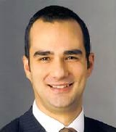
Opening Session: Collaborative Stories from Standards Groups around the World to Enable Seamless Travel and Business Solutions
Vanni Sanvicenti, Lead NDC Architect, International Air Transport Association (IATA)
Sandy Angel, Director of Specifications, OpenTravel Alliance
Jacob Dreyband, Senior Director of Software Development, Versonix Corporation Vittorio Carta, Manager European Projects and Committees, Deutsche Bahn
Emmanuel de Verdalle, Partner-Program Manager, DIGIMOBEE ITXPT
Mike Tinkey, CEO, OpenTravel Alliance (Moderator)
Next up: 12:15 – 14:00, Networking Lunch in the HITEC Amsterdam Exhibit Hall 10
Followed by: 14:00 – 15:00, Hot Topics Roundup: GDPR, Payment, Security

Slide 3
Next Generation Distribution Messaging (NGDM)
New standards are emerging.
OpenTravel - 2.0 Object Model
International Air Transport Association (IATA) - New Distribution Capability (NDC).
Both introduce the notion of “Offers and Orders” that brings the industry closer to a world of true retailing, enabling a richer booking experience and greater opportunities for cross-selling and up-selling, resulting in increased value.
These and other standard efforts, both open source and proprietary, are creating potential impacts on travelers, the hotel industry and the ecosystem.

Slide 4
Comparison of Industry Standards

Slide 5
NGDM High Level Conclusion
Collaboration between standards organizations
HTNG should continue to position itself and evolve its focus on hotel property level messaging
OpenTravel should remain focused on distribution messaging across all travel verticals
NDC should remain focused on air travel and air ancillary messaging
Develop and facilitate agreements allowing members to participate in each organizations efforts
http://c.ymcdn.com/sites/www.htng.org/resource/collection/091445d3-0150-4d4b-a5fa-9464a1e27423/NGDM_Recommendations_FINAL.pdf?hhSearchTerms=%22ngdm%22

Slide 6
International Air Transport Association (IATA)
New Distribution Capability (NDC)
POC NDC and OpenTravel 2.0 Hotel/Ground Transportation
Participation in each others hackathons
Collaboration and communication

Slide 7
HEDNA – Hotel Electronic Distribution Network Association
Participating in Work Groups
Participated in the HEDNA Hackathon - Austin

Slide 8
OpenTravel Hackathons
Virtual Hackathons
First Virtual Hackathon Completed
APIs provided by LinksRez, MASAI and NDC
Sponsor – LinksRez
Contributing Partner - HTNG
Onsite Hackathons

Slide 9
Introduction/Current Technology State
THE ULTIMATE RESERVATION SYSTEM

Slide 10
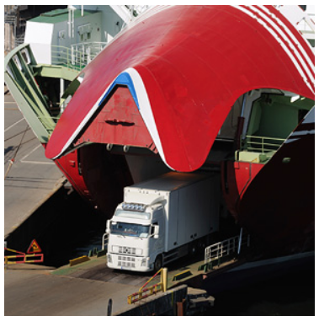
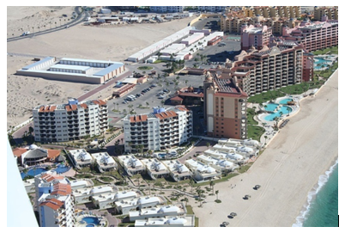
Corporate/Product Profile
Established in 1986
Located in San Jose, California
Corporation profitable since inception
Diverse staff of 65+ professionals around the world
Market demographic – Reservation system for leisure travel and transportation markets

Slide 11
Our Customers

Slide 12
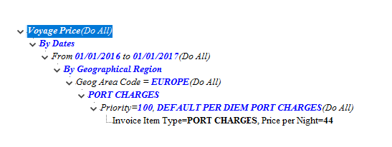
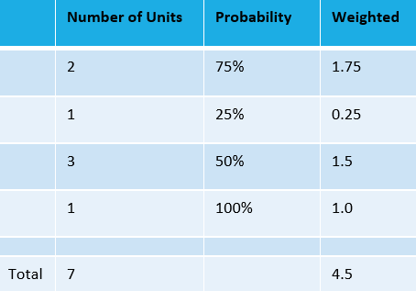
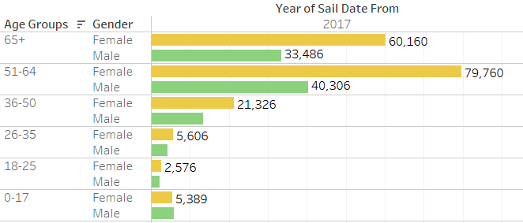
Unique Features
Built-in Revenue Management
Fully automated AI based Dynamic Pricing
Business Rules to support dynamic business policies
Inventory/Pricing
Financial
Intelligent support to manage cancellations
Patented technology using probability
Adoptable to various products/seasons
CRM
Guest/Agent Profile
Complete activity history
Loyalty program support (earn and redeem)
Dynamic Price in Action
Fill Progress %
Days to Sail

Slide 13
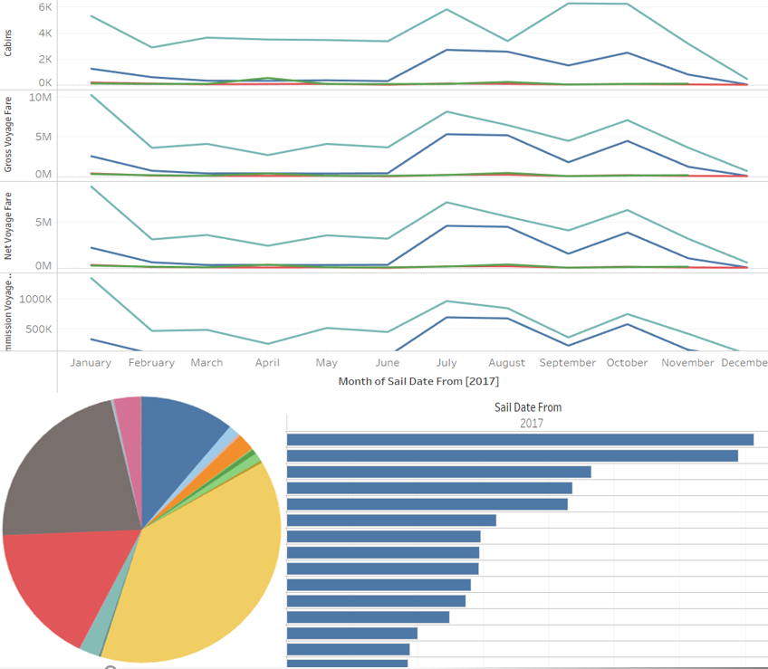
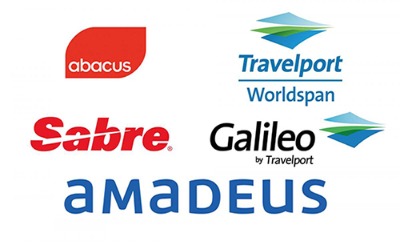
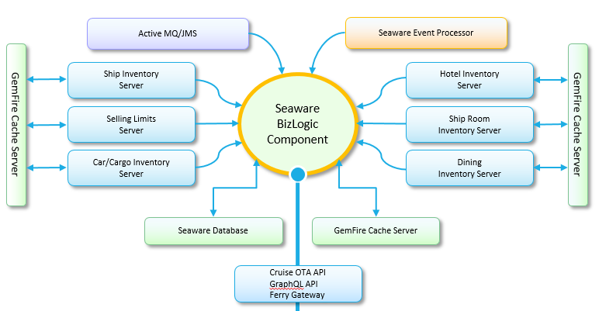
Latest Development
Transition to a new platform
Use of modern Technologies
Fault Tolerance
Support for Touch devices
New platform for B2C,B2B, Call Center and Mobile phone
Customizable flow for product marketing
Social Media integration
Login with special media account
Share profile
Salesforce integration
Data Analytics
Seaware DataMart
Integration with Tableau
External Distribution
OTA API Support
Ferry Gateway API
Car Deck Space Optimization
Monte Carlo method
Integrated Cargo and Passenger Cars space utilization
Utilization
Revenue
$
$
$
$
$
$
$
$
$
$
$
$
$
$
$
$
$
$
$
$
$

Slide 14
Full Service Model Initiative

Slide 15
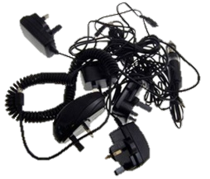
The market demands improved connectivity in rail distribution – But there are no modern standards yet
Ticketing interoperability is crucial for seamless travel across Single European Railway Area
But so far largely limited to
Proprietary technologies that worked well pre-digitalisation
UIC members
multiple bilateral solutions that are difficult to leverage
Issue resolution has been high on EP and Commission agendas for several years
EU regulations have so far not triggered innovation push
Sector has yet to demonstrate delivery capabilities and superiority of its approaches
Some data exchange in the background
Current situation (schematic)
3rd party ticket vendors

Slide 16
Besides significant legislative pressure the business context is changing dramatically – opportunities and threats for rail distribution
Regulatory framework
Business context
High EU expectations
TAP as baseline to get access to various data
But no dynamic pricing, no best price, no seamless sales process support etc.
Distribution = Cost factor vs. “owning the customer”
Open data vs. exploiting your own goldmine
Rail only vs. door-to-door
No plug and play technologies – which connectivity standard will prevail?
Third parties prying on ticket sales
ITS Delegated Act
CIRSRT
Distribution business models
Access to transport data
4th Railway Package
Sector approach:
Be cheerful and constructive, but only do the minimum → Sector’s TAP TSI governance
Specify a market-driven, cost-effective open IT framework for cross-carrier distribution and true interoperability → FSM
Embrace all relevant ticket vendors under sector terms → TAP TSI & FSM
Seems to have worked reasonably well since 2010. But the ice is becoming thinner.

Slide 17
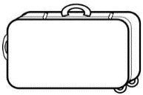
Market need for one-stop-shop distribution services: Customers expect easy and seamless travel solutions
Customers expect simple solutions for traveling
Rise of digital services increases expectations towards travel and distribution service providers
Ultimate goal: seamless travel solutions
Cooperation between travel and distribution service providers is necessary

Slide 18
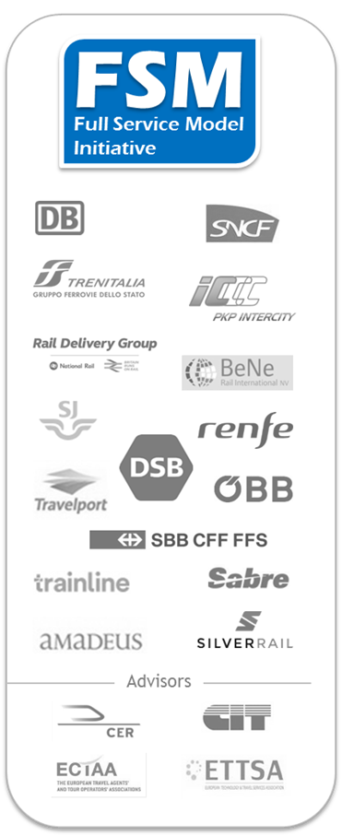
To overcome heterogeneous proprietary connectivity solutions the HLPM and distribution service providers initiated the Full Service Model
Full Service Model (FSM)
… is an Industry Initiative founded in 2013 aiming at developing an Open IT Specification
… enables B2B data exchange along the online distribution value chain
… relies on and goes upon European regulation regarding distribution and ticketing (e.g. TAP-TSI)
… complements costly individual bilateral IT-solutions between distributors and rail service provider
… follows a step-wise approach, i.e. it focuses on rail products in the beginning so as to manage complexity
… considers at the same time the context of multi-modality and allows, future enhancements in the direction of other modes of transport
https://tsga.eu/fsm

Slide 19
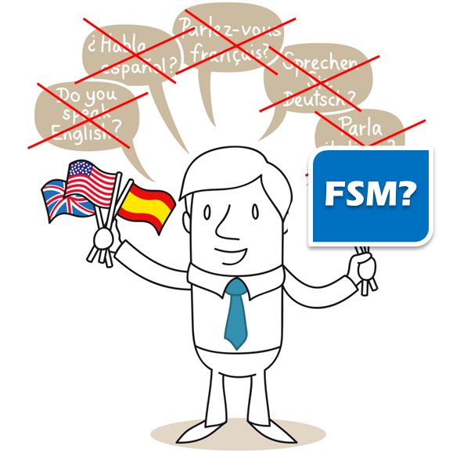
FSM simplifies distribution as it complements diverse individual and bilateral distribution solutions between business partners
What FSM is about
… the goal of FSM is to offer an alternative to the tangle of individual and bilateral IT-solutions
… FSM provides specifications that can be implemented in every IT distribution system
… FSM co-exists with other IT-solutions, companies can choose if they want to apply FSM specifications or any other IT-solutions
… FSM can be used for any distribution business model, that is, the content /the offer remains unchanged
FSM functions like a common language – companies can learn it, they can offer or order translation services, and they can continue speaking diverse other languages too

Slide 20
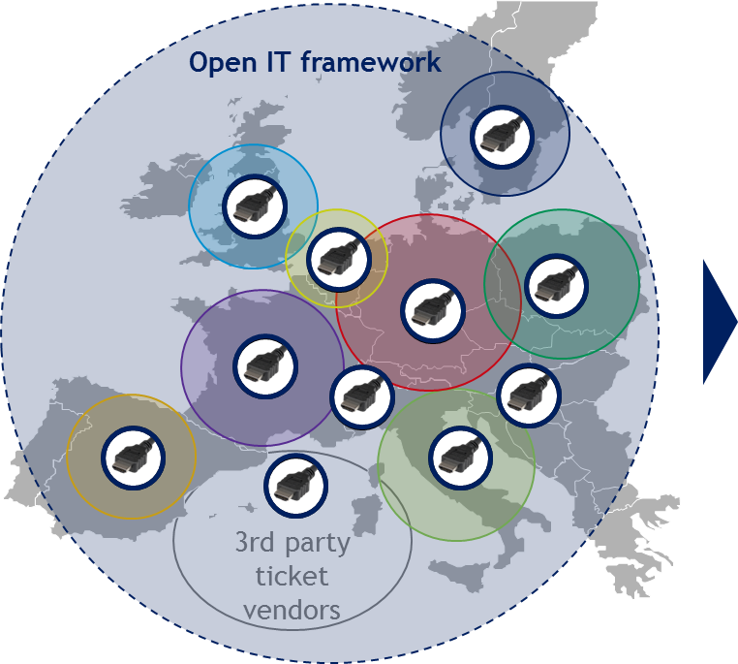
FSM approach: provide improved interoperability by specifying standardised B2B IT interfaces
FSM interface specifications
Innovative basis to interconnect rail distribution systems
As a result, this will reduce the boundaries of the current ecosystem
Framework enables maximum choice of business models
Thus, railways retain control of their own distribution strategies, while customers benefit from improved service and choice
Business relationship based on commercial agreements

Slide 21
FSM is based on six key principles

Slide 22
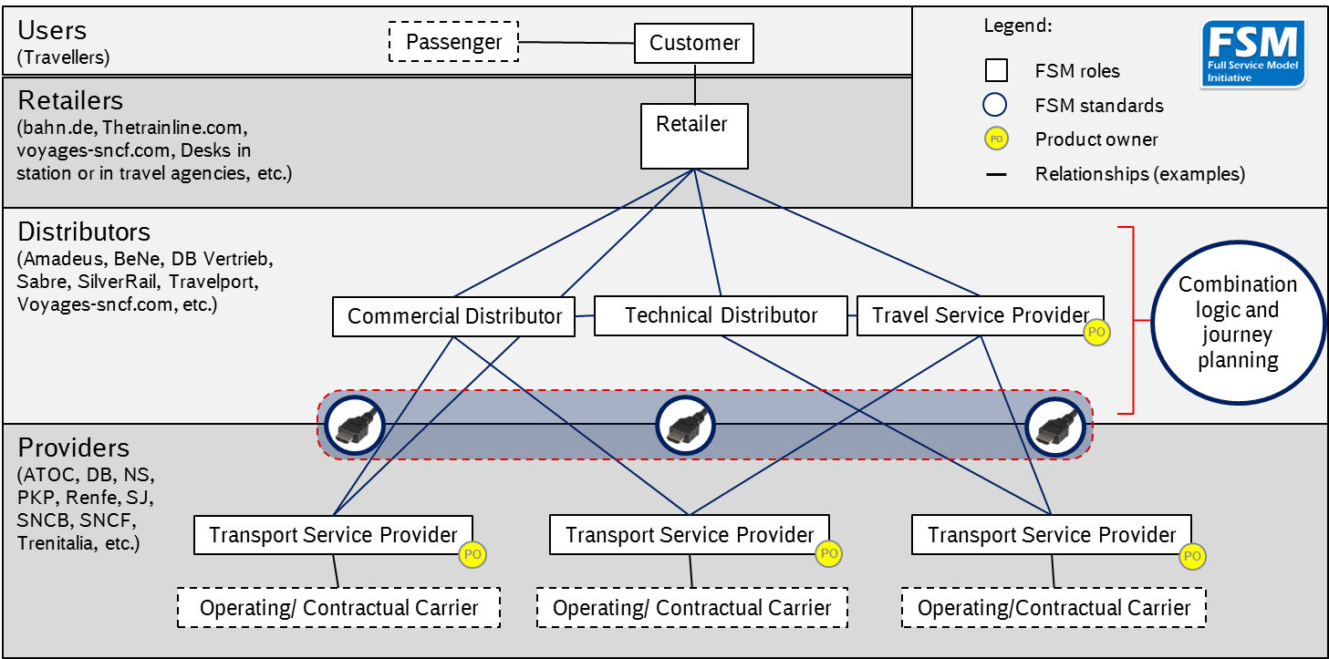
FSM specifies an online interface between rail distribution players to improve customer access to rail tickets

Slide 23
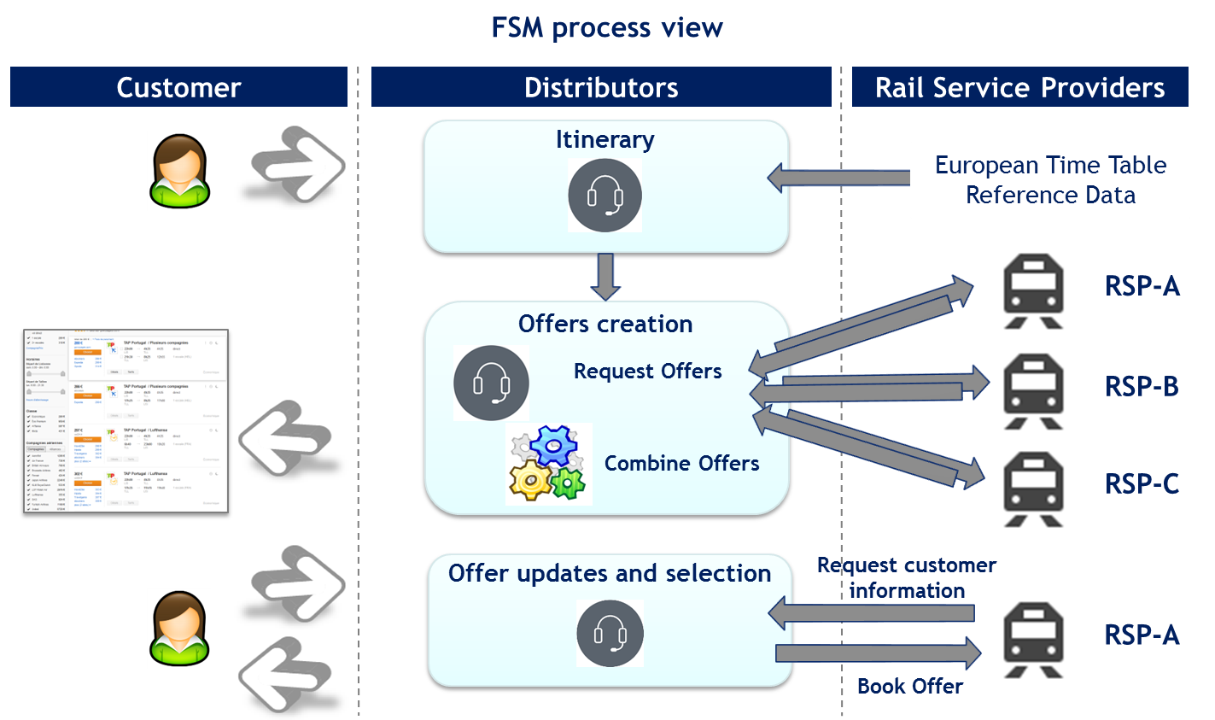
FSM covers the business processes between all players interacting to satisfy the needs of the customers

Slide 24
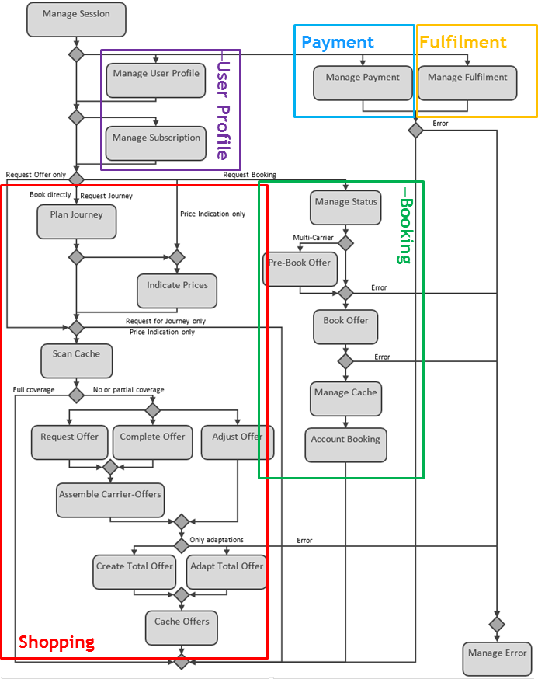
At design level the workflows and activities provide a common model of both computational and organisational processes
The activity diagram provides an overview on the sales process
Shopping consisting of journey planning and offering
Booking
Customer payment
Fulfilment
The most complex process is offering
User profile
Subscribed services
Price indication and forecast
Cache of offers
Creation, completion and adjustment of offers

Slide 25
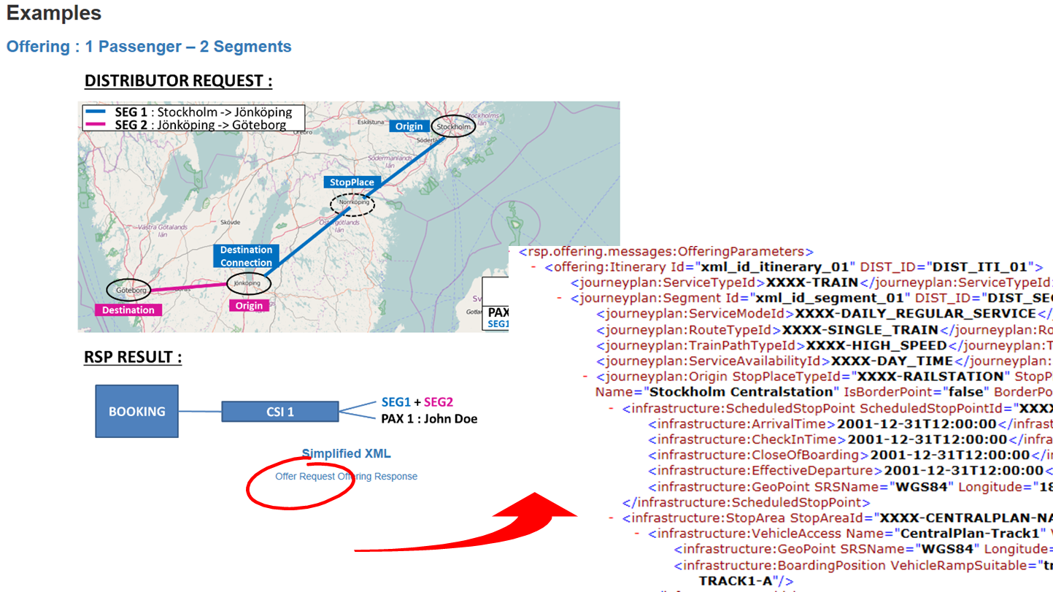
FSM provides business neutral XML messages enabling the data exchange between distributors and railways

Slide 26
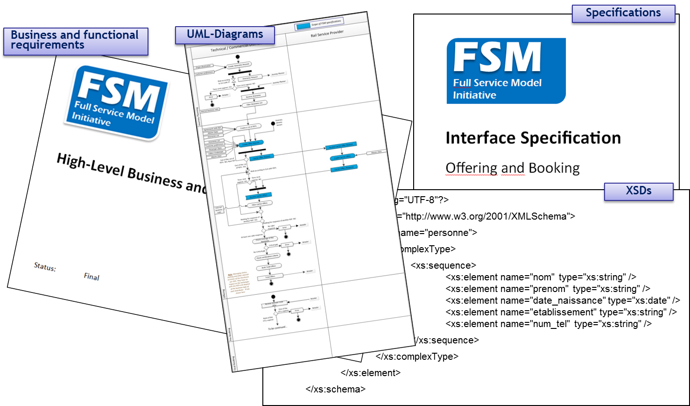
FSM offers a broad range of deliverables to get started

Slide 27
ITxPT - Information Technology for Public Transport
Latest status of ITxPT developments in terms of activities, technical development and implementation progress.

Slide 28
ITxPT
ITxPT develops and delivers specifications of a standardized IT architecture with open interfaces enabling interoperability for onboard and back-office IT systems in public transport

Slide 29
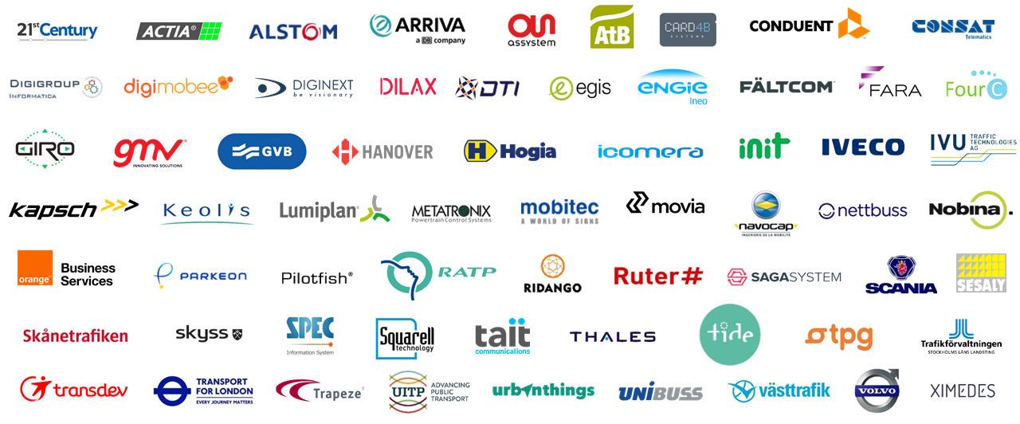
Memberships developement

Slide 30
Memberships developement
2018/Q4:
66
2017/Q4:
56
2017/Q2:
43
2017/Q1:
38
2016/Q4
29
9
2013
2016
2017
2018
(Founding Members)

Slide 31
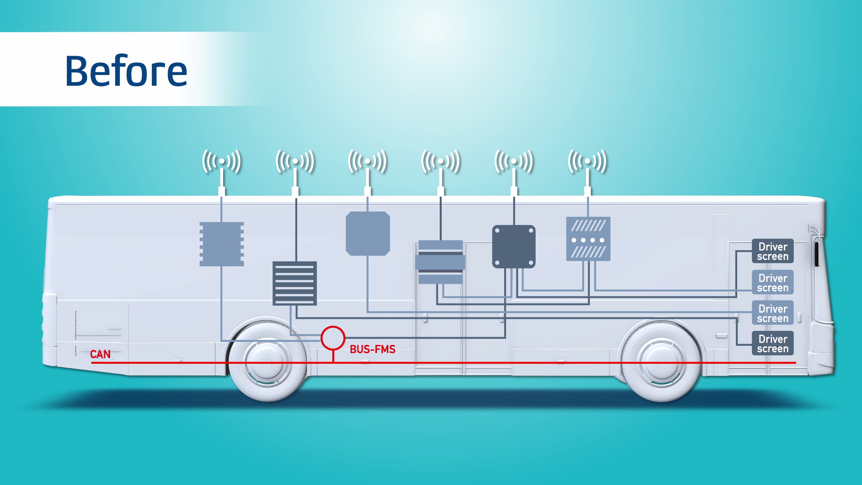

Slide 32
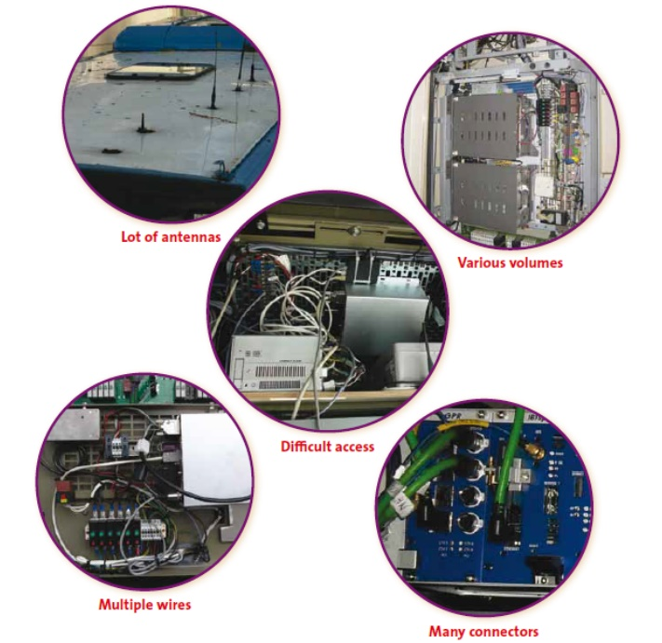
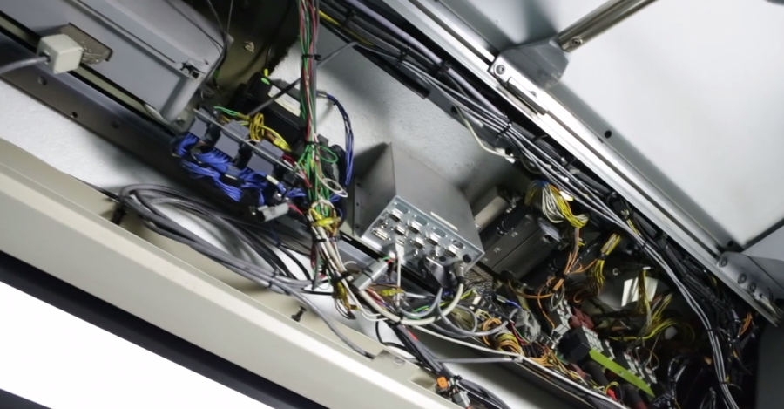
ITS issues today in Public Transport
Difficult installation
Redundancies (antennas, screens…)
Multi-connectors
Wiring issues
Maintenance access

Slide 33
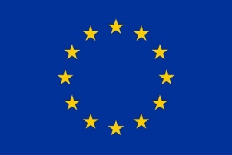
From innovation to implementation
Innovative collaborative projects
Specification +
Guideline
European support
CEN TC278 WG3
ITS – Transport Public

Slide 34
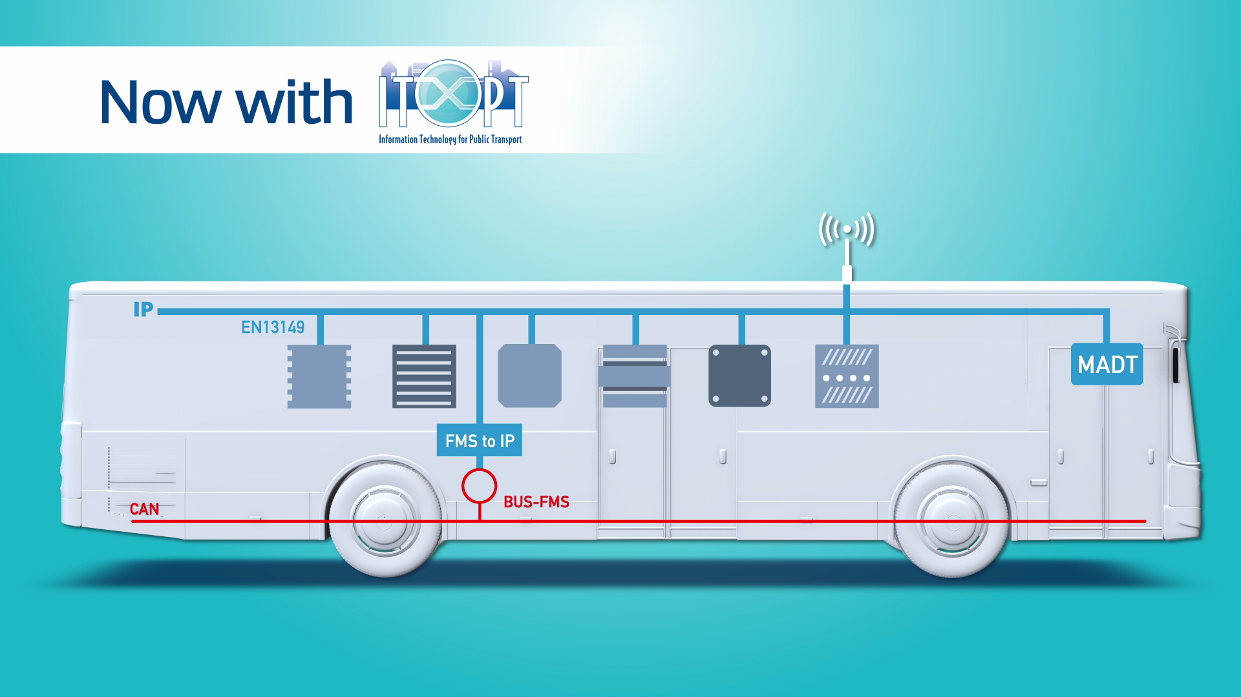

Slide 35
Other Industry references
Computing
Mobile Technology
Public Transport
IBM
Software
Ericsson
Various Apps
Vertical solutions
Back-office solutions
Servers
Switching & billing
Switches
Appli-cations
Base stations
PC & Mac
In-vehicle systems
Mobile phones
1990-2000
2000-2010
2010-2020

Slide 36
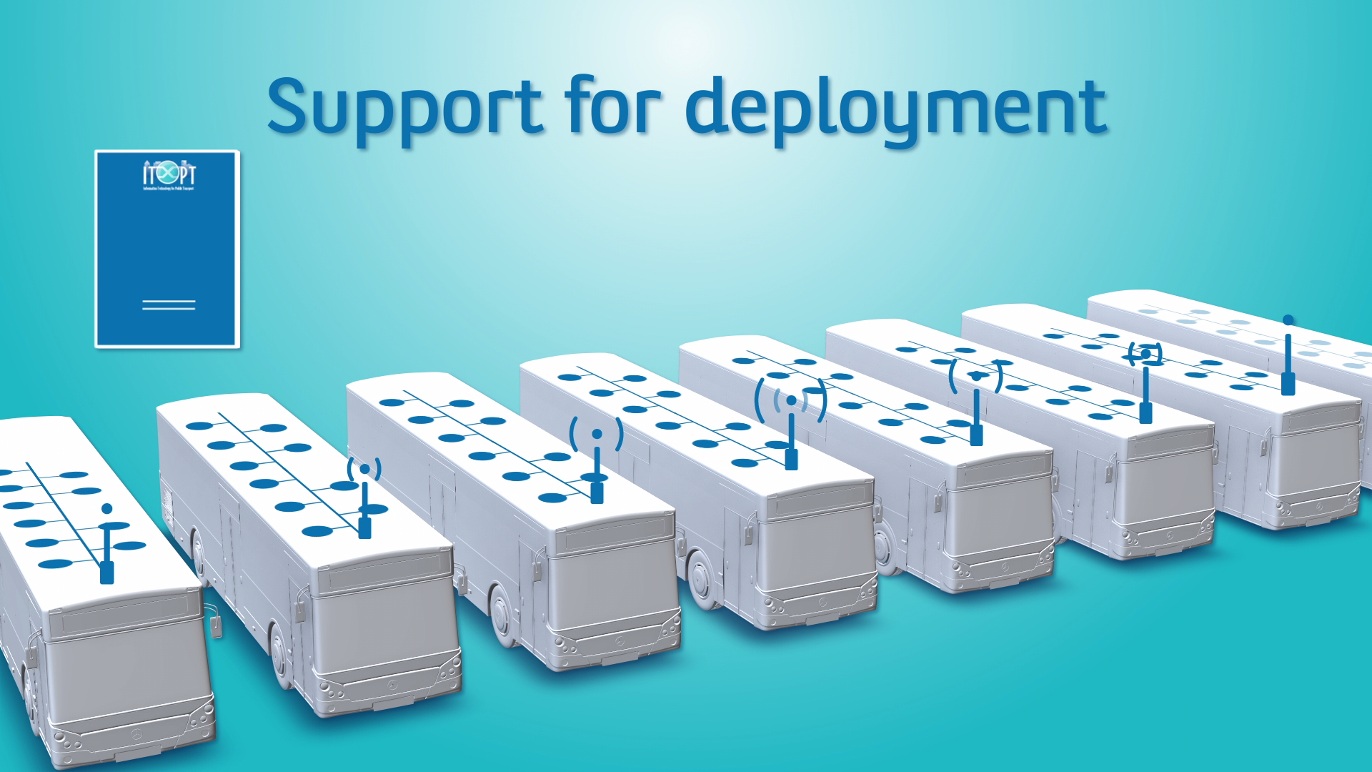

Slide 37
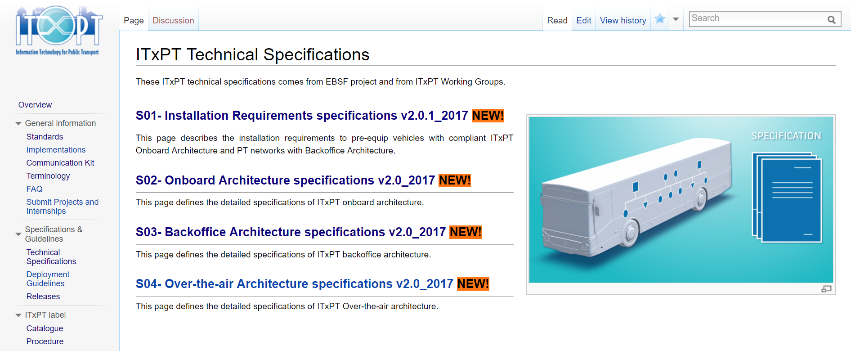
ITxPT Specification – documentation center

Slide 38
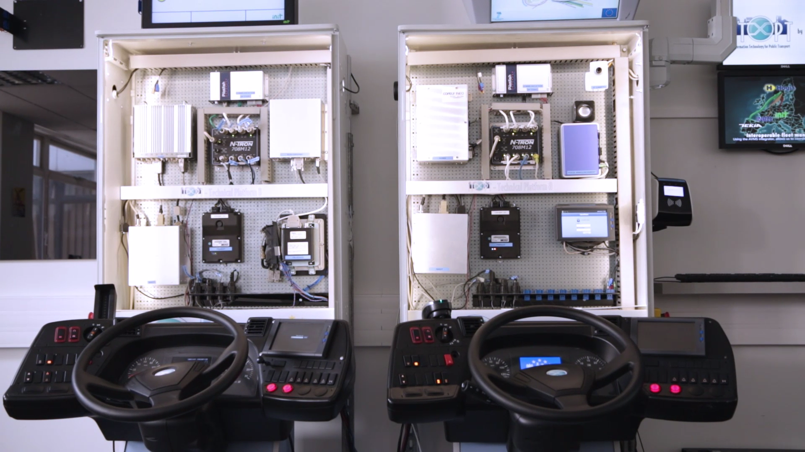
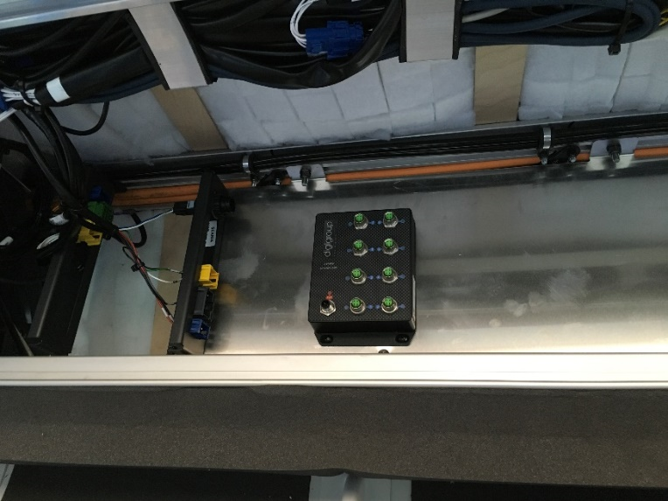
ITxPT Laboratory
ITxPT label
ITxPT platforms / testbench
Vehicle pre-preparation
Vehicle pre-preparation

Slide 39
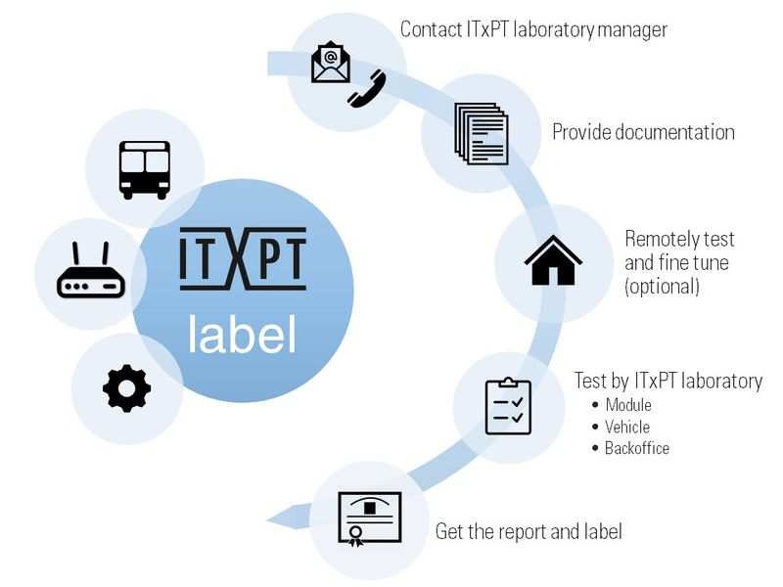
ITxPT Laboratory
Label procedure
Dedicated section is available in ITxPT documentation center
Test reports have been defined for vehicle, IT module and backoffice
ITxPT label is delivered by ITxPT laboratory
Label catalogue is available in ITxPT documentation center
ITxPT label ITxPT membership

Slide 40
2018 ITxPT working groups
# | Working group | Objective
5 | FMS needs collection | Analyze feedback from FMS group regarding ITxPT collection needs Evaluate impact for coming FMS release
6 | MQTT | Identify relevant use case to implement MQTT Define related MQTT services specification (content and data structure) Propose related update of S02 and G02 accordingly
7 | Additional IP services | Define specification for new services: DPI for formatted data in relation to Passenger Information, CCTV, bandwidth announcement and low battery Propose related update of S02 and G02 accordingly
8 | Security | Perform the risk analysys with the consultant Issue recommendations and propose related update of S02
9 | Over the air protocol | Analyse return from experiences and working group #9 outcomes Propose related update of S04
10 | SIRI/NeTEx | Preparation of EU call in the frame of EU priority action A: training action and Project Support Action (PSA)
11 | PT Trends to specification strategy | Understand impact of current and future trends (electrification, autonomous vehicles, mobility as a service, cooperative ITS, zero emission, etc.) to roadmap for developing the ITxPT specification
12 | Virtualization | Define technical solutions to decouple services from hardware, host multiple application on common hardware. Define impact and requirements on ITxPT specification
13 | Responsibility Model for interoperability | Legal, commercial, governance aspects when building an integrated ITxPT architecture
NEW
NEW
NEW

Slide 41
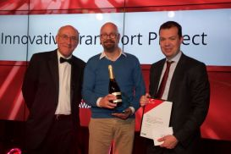
ITxPT implementation
Most Innovative Transport Project Winner
Transport for London, EBSF_2 London Demo: Introducing breakthrough IT standardisation on an existing bus fleet

Slide 42
Networking Luncheon
Enjoy Lunch in the HITEC Amsterdam Exhibit Hall – Hall 10!
Next up: 14:00 – 15:00, Hot Topics Roundup: GDPR, Payment, Security
Followed by: 15:00 – 15:30, Networking Break in Ruby Lounge

Slide 43
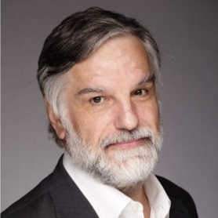
Hot Topics Roundup: GDPR, Payment, Security
Daniel Johnson, Partner, Co-Founder, Venza
Alvaro Hidalgo, Managing Partner, FIRST LOGIC Consulting, Chair HFTP’s GDPR Task Force
Next up: 15:00 – 15:30, Networking Break in Ruby Lounge
Followed by: 15:30 – 17:00 OpenTravel Challenge – Interactive Roundtable Session: Solutions for the Consumer Travel Experience Utilizing OpenTravel Standards

Slide 44
Hot Topic Roundup
GDPR, Data Security, Payments

Slide 45
Networking Break
Time for some coffee in the Ruby Lounge!
Next up: 15:30 – 17:00, OpenTravel Challenge
Followed by: 17:00 – 18:30, HITEC Amsterdam Welcome Networking Reception Exhibit Hall 10

Slide 46
Content Contributors / Presenters
Alvaro Hidalgo Managing Partner
First Logic Consulting
Daniel Johnson Partner/Co-Founder
VENZA

Slide 47
Hot Topics Agenda
The General Data Protection Regulation (GDPR)
Data Security Trends & Technologies
Payment Standards Updates

Slide 48
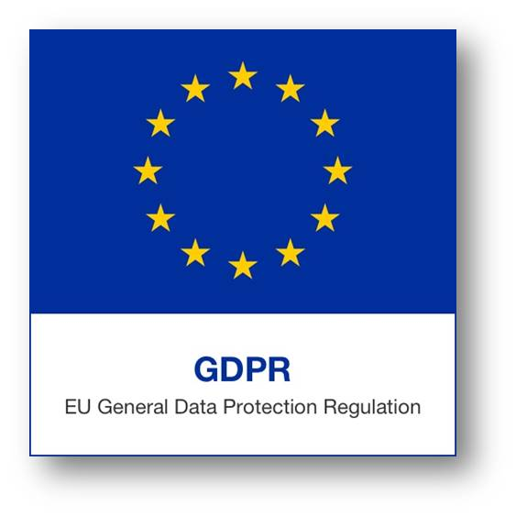
GDPR Topline Summary
GDPR
GDPR = General Data Protection Regulation
Determines that the “protection of natural persons in relation to the processing of personal data is a fundamental right …”
Four years of discussion resulted in a Regulation of 99 Articles
Replaces the EU Data Protection Directive of 1995
New penalties for non-compliance
Notes:
Discussion Points:
Although you may not be familiar with phrases such as Privacy by Design, Data Protection Impact Assessment (DPA), and Data Protection Officer (DPO) now, they (and many others) will soon become part of your day-to-day vocabulary.
1st objective of GDPR listed is to protect the natural persons in relation to the processing of personal data.
It took 4 years worth of discussion to create.
GDPR replaces the EU Data Protection Directive of 1995. What’s the difference? Regulations have binding legal force throughout every Member State and enter into force on a set date in all the Member States. Directives lay down certain results that must be achieved but each Member State is free to decide how to transpose directives into national laws.
The new regulation also comes with new penalties for non-compliance. Penalties can be as much as the greater of four percent of global turnover or 20 million Euros.

Slide 49
Consent
GDPR
Management of Client´s (Customers) Consent:
From the Client´s perspective:
How to obtain the specific, informed consent required by GDPR without overwhelming the customer
From the Operation´s perspective:
How to comply with GDPR requirements of purpose, accessibility, availability & security of the personal data.
How to identify, locate, modify and/or delete client´s personal data
From the Organization´s perspective:
How to Identify the extent of client´s consent in multi-stake operations
Stakeholders: Systems Vendors (PMS, CRM, etc); Distribution & Marketing; Loyalty programmes
Notes:
Alvaro

Slide 50
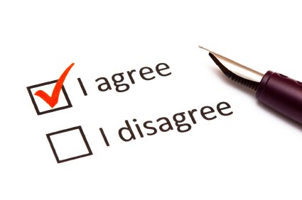
Consent
GDPR
“Clear affirmative act”
“Freely given”
“Informed indication of processing”
Easy to withdraw
Right to Erasure
Right to be Forgotten
Notes:
Discussion Points:
Consent is one of several means of making processing legitimate. Consent has to be given freely. The purpose of the processing of their personal data must be as easy to withdraw as to give consent. Consent must be “explicit” for sensitive data. The data controller is required to be able to demonstrate that consent was given. Existing consents may still work, but only provided they meet the new conditions.
(32) “Consent should be given by a clear affirmative act establishing a freely given, specific, informed and unambiguous indication of the data subject's agreement to the processing of personal data relating to him or her, such as by a written statement, including by electronic means, or an oral statement.”
This is the still controversial right to stay out of the public view and “be forgotten”.

Slide 51
Management of Personal Information
GDPR
What type of data is collected?
Ensures your collection has a legal basis and meets data protection principles
Embed data privacy into operations
Legal Basis
Legitimate Interest/Contractual necessity
Organize and classify your data inventories
How long is it retained?
Who collects it?
Be ready to respond to data subject’s requests
How is it collected and used?
Where is it stored? Transits before final storage
Maintain a flow chart for data flows
Who is it shared with? Internally and externally
Maintain data privacy policies

Slide 52
Management of Personal Data
GDPR
Management of Personal Data within organizations
Identify responsibility of the management of Personal Data in multi-stake operations:
Owner/Operator & Owner/Operator/Franchisor
Multi-brand Operator & Multi-brand Owner
Assess the GDPR impact in Management Contracts and Franchise Agreements
Personal Data Export: GDRP impact on Multinational companies operating within and out of the EU. Limitations to data export.
Management of Data by third parties
Categorize third parties: (Controller/Processor)
Third party vetting: ensure that third parties compliance
Notes:
Alvaro

Slide 53
GDPR Roles: Processor and Controller
GDPR
Third-Party Vendors
Data Ownership
Processor and Controller
The property is always a controller.
Must oversee all vendors
Notes:
Discussion Points:
Third-party vendors, who are the suppliers of these systems, are valuable partners for the property. However, when it comes to the data that is being processed, a common misconception is that an accountability-based law like the General Data Protection Regulation (GDPR) somehow relates to the subject of data ownership.
This is incorrect. In terms of the GDPR, there are two roles—processor and controller. The property is always the controller. As such, the property must oversee its vendors to ensure that they follow best practices for data protection.

Slide 54
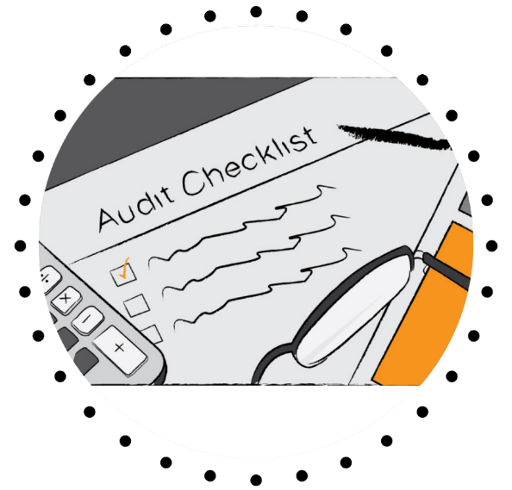
GDPR Roles: Controllers
GDPR
Assessing data capture and risk
Implementing data protection principles
Reviewing and updating measures to ensure compliance
Notes:
Discussion Points:
The data controller determines the purposes for which the data will be used, collects the data and establishes the means by which it will be processed. Data controllers have the greatest amount of responsibility under the GDPR, including but not limited to:
Assessing data capture and risk
Implementing data protection principles
Reviewing and updating measures to ensure compliance

Slide 55
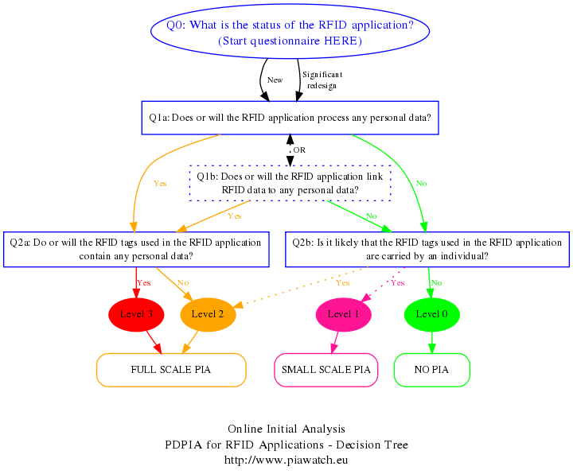
GDPR Roles: Controllers and the DPA
GDPR
Controller’s Responsibility
Evaluate operations
Focus on “high risk”
Contains
System description
Necessity statement
Risks
Measures
Notes:
Discussion Points:
Data Protection Impact Assessments must be conducted by Data Controllers.
It evaluates processing operations w/ a focus on high risk information that is “sensitive” in nature – “rights and freedoms of natural persons”
Must contain:
Systematic description
An assessment of necessity and proportionality
Risk assessment
Measures envisaged to address the risks (safeguards, security measures and mechanisms) to ensure protection and regulation compliance.
(84) “In order to enhance compliance with this Regulation where processing operations are likely to result in a high risk to the rights and freedoms of natural persons, the controller should be responsible for the carrying-out of a data protection impact assessment to evaluate, in particular, the origin, nature, particularity and severity of that risk. The outcome of the assessment should be taken into account when determining the appropriate measures to be taken in order to demonstrate that the processing of personal data complies with this Regulation. Where a data-protection impact assessment indicates that processing operations involve a high risk which the controller cannot mitigate by appropriate measures in terms of available technology and costs of implementation, a consultation of the supervisory authority should take place prior to the processing.”

Slide 56
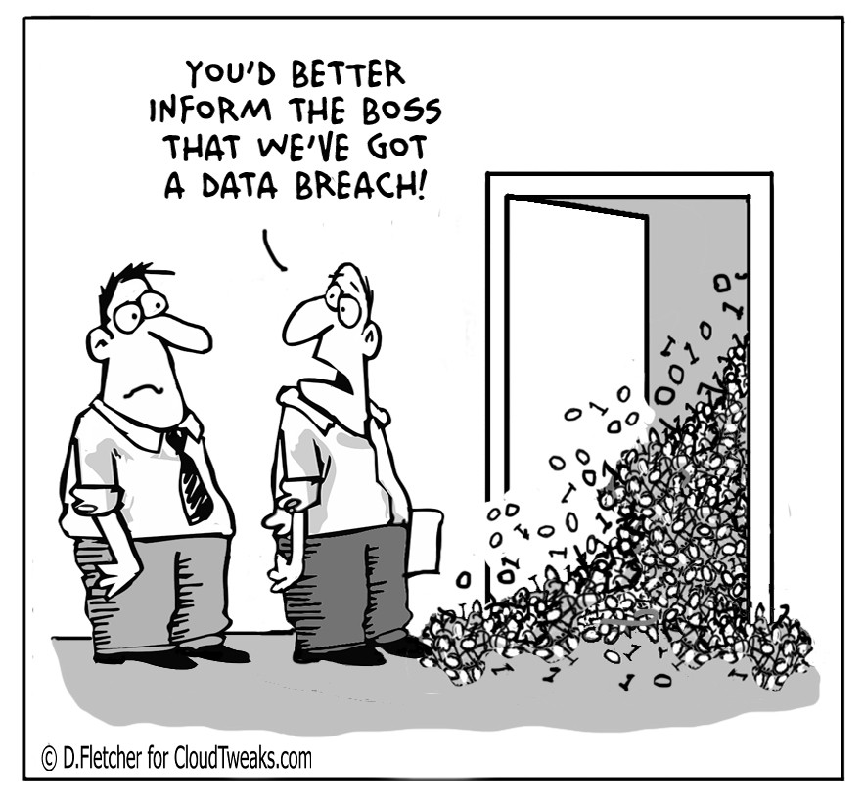
GDPR Roles: Data Breach Notification
GDPR
Data Controller has 72 hours to notify DPO
Serious breaches require notification of data subjects
Not unlike current guidelines (i.e. UK ICO)
Notes:
Discussion Points:
Data controllers must notify most data breaches to the DPO. This must be done without undue delay and, where feasible, within 72 hours of awareness. A reasoned justification must be provided if this timeframe is not met.
In some cases, the data controller must also notify the affected data subjects without undue delay. In cases of “high risk to their rights and freedoms”.
The text looks burdensome on both data controllers and DPOs. However, in some sectors, organizations already have an obligation to notify data breaches.

Slide 57
GDPR Roles: Processor (pt. 1)
GDPR
Data Processors have obligations:
Maintain written record of activities
Data Protection Impact Assessments (DPIA)
Designate a Data Protection Officer (DPO)
Appoint representative (if not EU)
Provide notifications
Notes:
Discussion Points:
One of the key changes in the GDPR is that data processors have direct obligations for the first time. These include an obligation to: maintain a written record of processing activities carried out on behalf of each controller; designate a data protection officer where required; appoint a representative (when not established in the EU) in certain circumstances; and notify the controller on becoming aware of a personal data breach without undue delay.
The GDPR requires a lot from a data controller. However, that does not mean that data processors are unaffected. It’s just the opposite, actually. For the first time, under the GDPR, data processors have data protection obligations. These obligations include the following tasks:
Maintaining a written record of processing activities carried out on behalf of each controller
Designating a data protection officer (or DPO) where required
Cooperating with the Supervisory Authority and notifying, without delay, the controller when they becoming aware of a data breach. If sensitive information is involved, the processor is required to notify the data subject or subjects directly.

Slide 58
Poll
GDPR
Who has more responsibility, the Controller or the Processor?
They have equal responsibilities.
The controller because the processor manages data on behalf of the controller; the controller decides what to do with the data.
The processor because the controller manages the data on behalf of the processor; the processor decides what to do with the data.
Notes:
Who has more responsibility, the Controller or the Processor?
They have equal responsibilities.
The controller because the processor manages data on behalf of the controller; the Controller decides what to do with the data.
The processor because the controller manages the data on behalf of the processor; the processor decides what to do with the data.

Slide 59
GDPR Roles: Processor (pt. 2)
GDPR
Cross border transfers
Binding Corporate Rules (BCRs)
Includes “online identifiers”
Notes:
Discussion Points:
One of the key changes in the GDPR is that data processors have direct obligations for the first time. These include an obligation to: maintain a written record of processing activities carried out on behalf of each controller; designate a data protection officer where required; appoint a representative (when not established in the EU) in certain circumstances; and notify the controller on becoming aware of a personal data breach without undue delay.
The GDPR requires a lot from a data controller. However, that does not mean that data processors are unaffected. It’s just the opposite, actually. For the first time, under the GDPR, data processors have data protection obligations. These obligations include the following tasks:
Maintaining a written record of processing activities carried out on behalf of each controller
Designating a data protection officer (or DPO) where required
Cooperating with the Supervisory Authority and notifying, without delay, the controller when they becoming aware of a data breach. If sensitive information is involved, the processor is required to notify the data subject or subjects directly.

Slide 60
Tech Stack & Flow: Privacy by Design
GDPR
PbD is nothing new, but:
Collection must be minimized
Retention and Consent must be formalized
“Adopt Policies”
“Implement measures”
“Pseudonymizing”
Transparency
Monitoring
Notes:
Discussion Points:
Privacy by Design (PbD) has always played a part in EU data regulations. But with the new law, its principles of minimizing data collection and retention and gaining consent from consumers when processing data are more explicitly formalized.
(78) “In order to be able to demonstrate compliance with this Regulation, the controller should adopt internal policies and implement measures which meet in particular the principles of data protection by design and data protection by default.“
It also references …
“…pseudonymising personal data as soon as possible, transparency with regard to the functions and processing of personal data, enabling the data subject to monitor the data processing, enabling the controller to create and improve security features. ”

Slide 61
Tech Stack & Flow: Data Landscape
GDPR

Slide 62
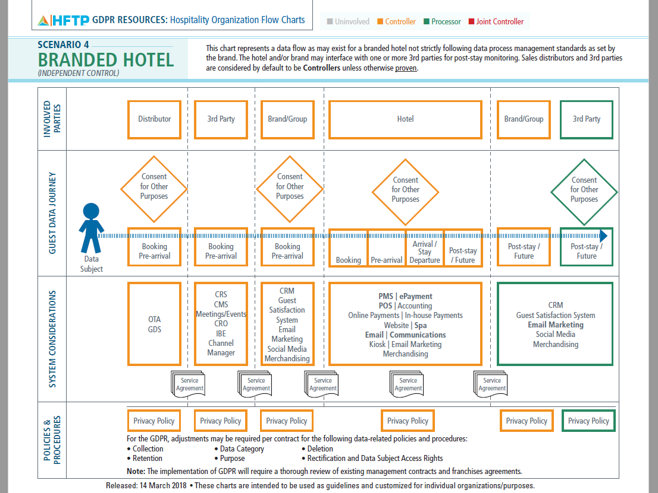
Tech Stack & Flow: Data Flow Diagrams
GDPR

Slide 63
Poll
GDPR
Do non-EU-based organizations need to prepare for GDPR?
No
Yes
Yes … but only if they are offering services and/or monitoring the behavior of European-based data subjects.
Notes:
Do non-EU-based organizations need to prepare for GDPR?
No
Yes
Only if they are offering services and/or monitoring the behavior of European-based data subjects.

Slide 64
Extra-Territorial Scope (Article 3)
GDPR
What organizations?
Non-EU orgs who target or monitor EU data subjects
Non-EU orgs who process personal data about EU data subjects in connection with data or transactions.
Goods and Services
“Monitoring of Behaviour”
Notes:
Discussion Points:
Article 3.1 “This Regulation applies to the processing of personal data in the context of the activities of an establishment of a controller or a processor in the Union, regardless of whether the processing takes place in the Union or not.”
“Offering goods or services” is more than mere access to a website or email address, but might be evidenced by use of language or currency generally used in one or more Member States with the possibility of ordering goods/services there, and/or monitoring customers or users who are in EU. “Monitoring of behaviour” will occur, for example, where individuals are tracked on the internet by techniques which apply a profile to enable decisions to be made/predict personal preferences, etc. Does a controller or processor "envisage" offering services to data subjects in one or more Member States? If so, GDPR applies!
Note: the data subject is not required to offer payment for a good or service.

Slide 65
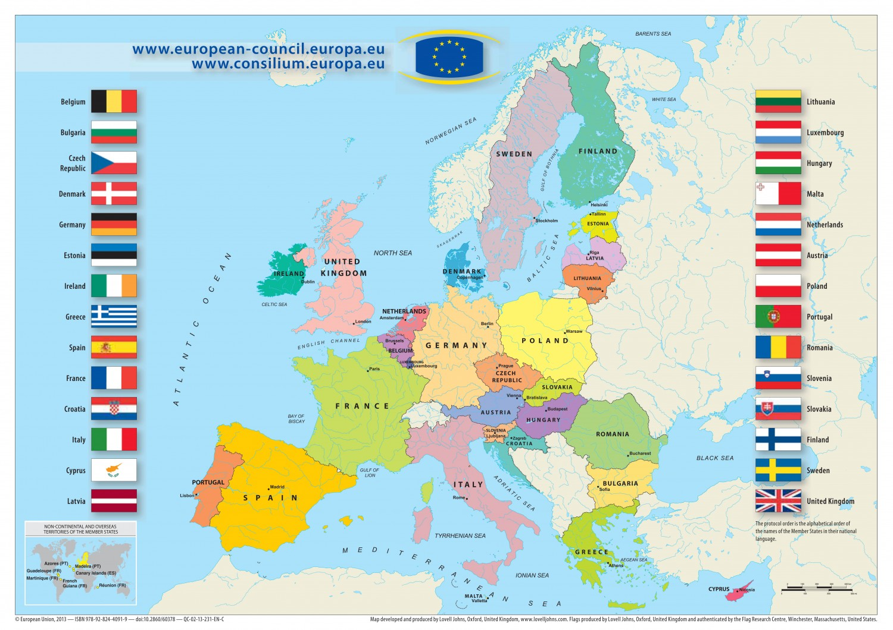
Repercussions: Legislative Summary
GDPR
GDPR is legally aligned with Article 8(1) of the ‘Charter’ and Article 16(1) of the TFEU
Text translated 24 languages
Approved 16.04.17
Enforcement begins 25.05.18
EU = 28 nations
EU Parliament = 751 members
Notes:
Discussion Points:
It is a “fundamental right” as listed in Article 8 of the Charter of fundamental Rights of the European Union … known as “The Charter”.
Also Article 16 of the Treaty on the Functioning of the European Union.
In Jan. of last year it was translated into 24 languages
Approved in April by EU Parliament. Enforcement next May. Across 28 nations.

Slide 66
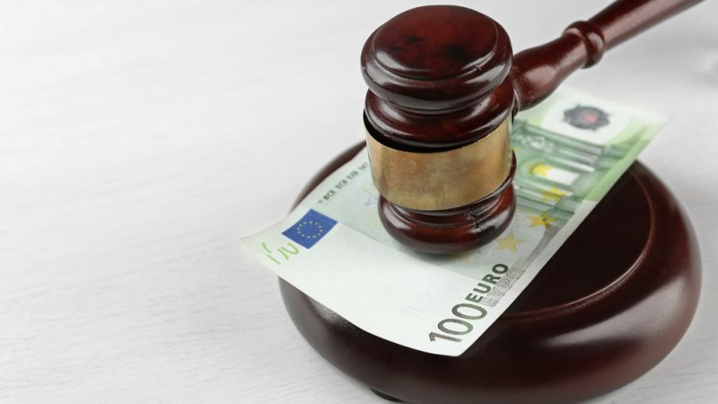
Repercussions: Legal
GDPR
Globally applied to any organization processing or storing personal data of EU citizens:
Offering goods and/or services
Monitoring behavior
Two types of fines for infringement:
Not adhering to core principles = €20 million (or 4% of rev)
Not adhering to requirements = €10 million (or 2% of rev)
Accountability = Article 5(2)
Notes:
Discussion Points:
GDPR applies to businesses that process and store PII.
Fines are stiff.
4mil EU for “Failure to adhere to the core principles of data processing, infringement of personal rights, or the transfer of personal data.” Article 44
2mil EU for “failure to comply with technical and organizational requirements such as impact assessments, breach communications and certifications” Articles 25, 32, 33, 35
Note: GDPR is an Accountability-based privacy law where the controller has a legal obligation. This aspect has made GDPR the subject of much attention. Although it isn’t the first Accountability-based privacy law; Canada passed one in 2002.

Slide 67
Poll
GDPR
Who needs a Data Protection Officer (DPO)?
All organizations that must be GDPR compliant
Any company managing a relevant amount of personal data of European-based Data Subjects
All organizations
Notes:
Who needs a Data Protection Officer (DPO)?
All organizations that must be GDPR compliant
Any company managing a relevant amount of personal data of European-based Data Subjects
All organizations

Slide 68
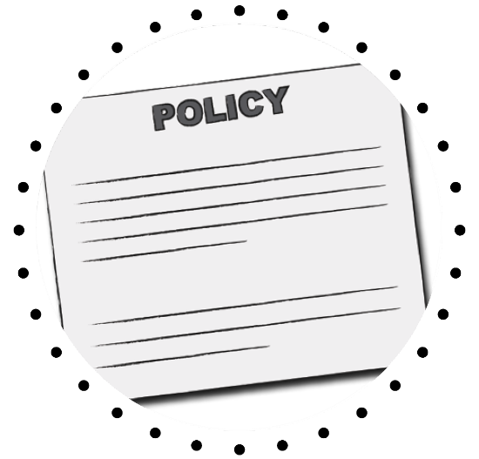
Importance to Our Industry (pt. 1)
GDPR
Need
GUIDELINES:
GDPR compliant Privacy Policy
Compliance with GDPR outside EU
Who needs a DPO?
List of Definitions: Controller & Processor; Entity; Privacy Impact Assessment; Privacy by Default, etc
Notes:
Alvaro

Slide 69
Importance to Our Industry (pt. 2)
GDPR
Understand
HOSPITALITY DATA PROTECTION OFFICER (HDPO)
Profile of the DPO for Hospitality:
What profile (JD) is best for a Hospitality DPO?
Who can and who cannot be a DPO? Conflicts of interest?
Job Description of the HDPO: Specific HDPO vs generic DPO
HDPO Certification & Structure
Must - COMMUNICATION & AWARENESS
Notes:
Alvaro
April 2017 – HFTP Put together a team of experts to prepare supporting resources for the industry. Specifically, the association has recruited an advisory council to develop Hospitality Data Protection Officer (HDPO) Guidelines along with a Hospitality Data Protection Officer certification program, with a release date of Summer 2017.

Slide 70
What HFTP is doing … (pt. 1)
GDPR
Creating an HDPO Sample Job Description to include an executive summary and sample templates/models
Reviewing Registration Cards
Gathering diagrams of personal data flow in different hospitality organizations
Examples of data flows (SEE slide #17)
Examples of hospitality project management
Notes:
Alvaro
April 2017 – HFTP Put together a team of experts to prepare supporting resources for the industry. Specifically, the association has recruited an advisory council to develop Hospitality Data Protection Officer (HDPO) Guidelines along with a Hospitality Data Protection Officer certification program, with a release date of Summer 2017.

Slide 71
What HFTP is doing … (pt. 2)
GDPR
Creating conflict of interests lists
Creating suggested reporting lines for the HDPO
Ensuring GDPR glossary of terms in Pineapplesearch
Creating a standard template for (PMS) vendors to request progress details towards GDPR compliance
Creating a sample privacy policy that is GDPR compliant
Awareness, Awareness, Awareness
Notes:
Alvaro
April 2017 – HFTP Put together a team of experts to prepare supporting resources for the industry. Specifically, the association has recruited an advisory council to develop Hospitality Data Protection Officer (HDPO) Guidelines along with a Hospitality Data Protection Officer certification program, with a release date of Summer 2017.

Slide 72
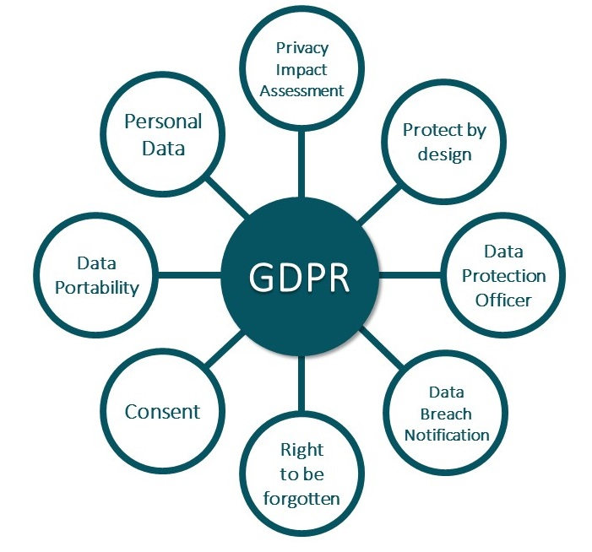
GDPR Basics
GDPR
Notes:
Discussion Points:
It’s been said that “the EU's citizen-driven, regulated model will swiftly come into conflict with the market forces of the US and the UK.”
Whether that is true will likely be made evident in the coming months … with GDPR and it’s May 25th, 2018 enforcement.

Slide 73
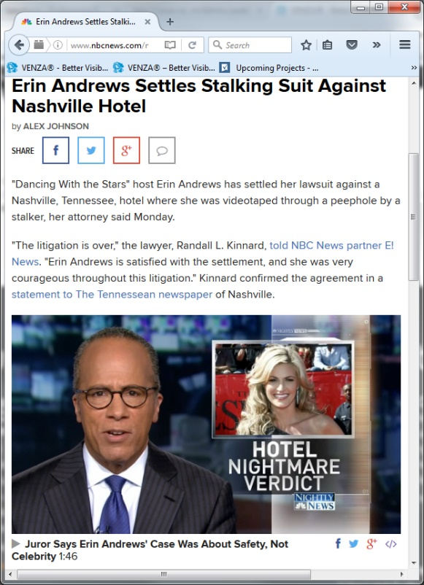
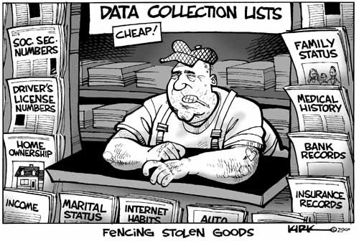
Data Security Topline Summary
Data Security
85% of business assets in digital form
$6 trillion cost (aver.) per year
$11.7 million (aver.) for security
27.4% increase in breaches (130)
Big Data!
Notes:
Discussion Points:
And for the present day, well, cybercrime continues to grow:
Why? 85% of business assets are in digital form
A damaged reputation is difficult and costly to repair.
$6 Trillion cost on average per year
$11.7 million is the cost for cybersecurity on average however … the average for travel/hospitality is $6.2 million
27.4% yearly increase in security breaches
Data sets are growing rapidly - in part because they are increasingly gathered by cheap and numerous information-sensing Internet of things devices such as mobile devices, aerial (remote sensing), software logs, cameras, microphones, radio-frequency identification (RFID) readers and wireless sensor networks

Slide 74
Complex Landscape for Hospitality/Travel
Data Security
Hospitality/Travel consistently in Top 3 Most Targeted (especially POS)
Ransomware attacks increased by 27%
15% rate
23 days (aver.) to resolve
52% of data breaches are due to human error
Notes:
Privacy/Data Security ... An ever more complex landscape
Hospitality/Travel in Top 3
Your Biggest Targets: POS (91% of Breaches)
1 million malware attacks daily Recent analysis indicates that 15% of users fall victim once, and 3% click on phishing links more than twice. (Source: 2017 Verizon Data Breach Investigations Report) For this reason, it’s not enough to have just a response plan in place. Prevention through the use of education—and even simulated attempts—is key. Accenture estimates 23 days on average to resolve a ransomware attack.
52% of data breaches are due to human error.

Slide 75
Return: Complex Tech. Landscape
Data Security

Slide 76
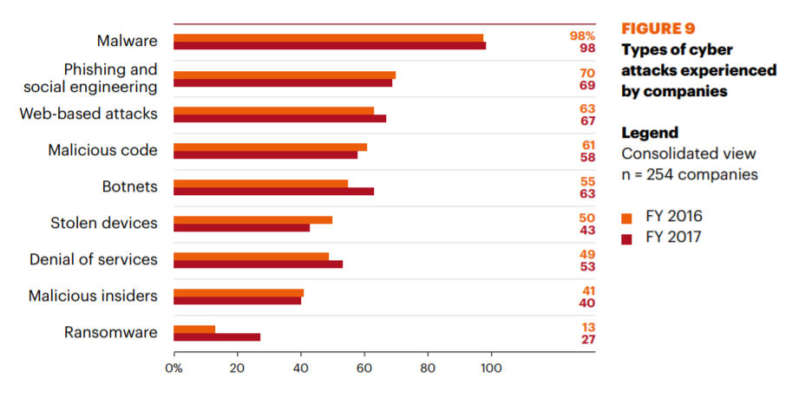
Types of Attacks - Frequency
Data Security
https://www.accenture.com/t20170926T072837Z__w__/us-en/_acnmedia/PDF-61/Accenture-2017-CostCyberCrimeStudy.pdf

Slide 77
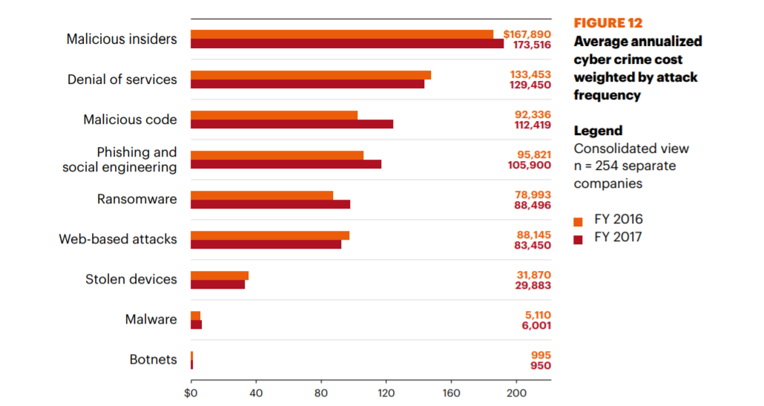
Types of Attacks - Costs
Data Security
https://www.accenture.com/t20170926T072837Z__w__/us-en/_acnmedia/PDF-61/Accenture-2017-CostCyberCrimeStudy.pdf

Slide 78
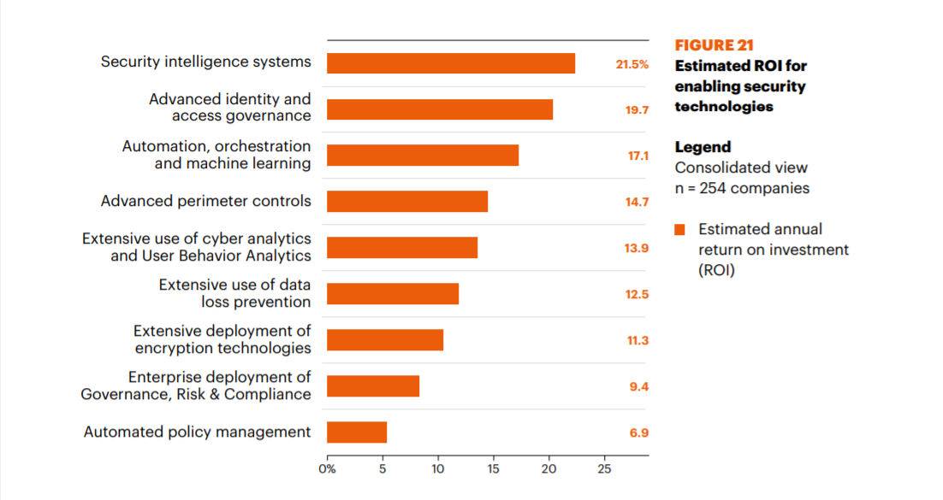
Technologies & ROI
Data Security
Notes:
The best bang for your buck now is through predictive security intelligence systems and identity and access governance.
Security-intelligence systems are designed to collect vast amounts of information on digital threats, which are rapidly becoming primary dangers to the autonomy and power of nations, businesses and private citizens.

Slide 79
Side by Side
Data Security

Slide 80
Data Security “The 5 Must Haves”
Data Security
#1 Risk Assessment
#2 Penetration Test
#3 Network Assessment
#4 Cyber Risk Warning Alert
#5 Phishing Simulator

Slide 81
Top 5 Trends in Payments (by Capgemini)
Payments
Trend 01: Banks becoming platform players to aid collaboration, retain payments’ role
Trend 02: Infrastructure rationalization is likely as payments intermediaries come together or evolve
Trend 03: Payment vendors and banks are expected to consolidate their operations to form larger groups
Trend 04: Open APIs enable stakeholder collaboration
Trend 05: Alternate payment channels such as contactless and wearables gain acceptance
https://www.capgemini.com/wp-content/uploads/2017/12/payments-trends_2018.pdf

Slide 82
Top 10 Trends in Payments (by Capgemini)
Payments
Trend 06: Banks and FinTechs explore distributed ledger technology to transform cross-boarder payments
Trend 07: Instant payments processing likely to become the ‘new normal’ for corporate treasurers, industry at large
Trend 08: As global cyberattacks rise, regulators focus on data-privacy law compliance
Trend 09: Robotic process automation, machine learning help payment service providers in fraud detection
Trend 10: Payments firms continue to invest in advanced authentication technologies to fight fraud and data breaches

Slide 83
PCI DSS News in 2018
Payments
PCI DSS 3.2 Effective Date for New Requirements has Come and Gone
Change mgmt. processes to confirm requirements are in place
Multi-factor authentication for all non-console administrative access
Maintain documented description of cryptographic architecture
Detect and respond to failures
Perform pen test on segmentation controls every six months
Establish PCI DSS compliance program
Quarterly reviews of policies and procedures
Notes:
February of 2018 PCI DSS 3.2 Effective Date for New Requirements has Come and Gone
Change mgmt. processes to confirm requirements are in place
Multi-factor authentication for all non-console administrative access
Maintain documented description of cryptographic architecture
Detect and respond to failures
Perform pen test on segmentation controls every six months
Establish PCI DSS compliance program
Quarterly reviews of policies and procedures

Slide 84
PCI DSS News in 2018
Payments
June 30, 2018 is the Deadline for SSL/Early TLS Migration
Secure Sockets Layer (SSL) and early versions of Transport Layer Security (TLS) are no longer considered secure forms of encryption.
It is critically important that organizations upgrade to a secure version of TLS – such as TLS v1.2 or higher – as soon as possible and disable any fallback to SSL/early TLS.
Note: POS POI terminals that are verified as not being susceptible to any known exploits, and the service provider termination points to which they connect, may continue using SSL/early TLS as a security control.
Notes:
June 30, 2018 is the Deadline for SSL/Early TLS Migration
Secure Sockets Layer (SSL) and early versions of Transport Layer Security (TLS) are no longer considered secure forms of encryption.
It is critically important that organizations upgrade to a secure version of TLS – such as TLS v1.2 or higher – as soon as possible and disable any fallback to SSL/early TLS.
Transport layer security (TLS) is a protocol that provides communication security between client/server applications that communicate with each other over the Internet. It enables privacy, integrity and protection for the data that's transmitted between different nodes on the Internet.
Note: POS POI terminals that are verified as not being susceptible to any known exploits, and the service provider termination points to which they connect, may continue using SSL/early TLS as a security control.

Slide 85
PCI DSS News in 2018
Payments
Minor PCI DSS Revision Expected this Year
A minor revision to PCI DSS v3.2 is planned for mid-2018.
No new requirements are planned for this revision.
Notes:
Minor PCI DSS Revision Expected this Year
A minor revision to PCI DSS v3.2 is planned for mid-2018.
No new requirements are planned for this revision.

Slide 86
PCI DSS News in 2018
Payments
Full PCI DSS Revision is Under Development
Notes:
Full PCI DSS Revision is Under Development

Slide 87
PCI DSS Goals
Payments
Notes:
Payment Card Industry Data Security Standard (PCI DSS) has been developed by a collaboration of the credit card companies including VISA, American Express, Mastercard, and JCB. The purpose of the standard is to advance cardholder data security globally. This comprehensive standard is intended to reduce the risk of data breaches by guiding merchants with specific requirements to protect customer account data. The program is administered by the PCI Security Standards Council. Requirements are defined for security management, policies, procedures, network architecture, software design and other critical protective measures. PCI DSS is comprised of 6 Categories (Goals) including 12 Requirements.

Slide 88
Software-based PIN on COTS Standard
Payments
Software-based approach to protect PIN entry on COTS
For Contact and Contactless transactions
PIN entry with Secure Card Reader
Notes:
Are you aware you can except payments via software based applications versus hardware terminals according to the new PCI standard.

Slide 89
Any questions?
Q&A

Slide 90
OpenTravel Challenge - Interactive Roundtable Session: Solutions for the Consumer Travel Experience Utilizing OpenTravel Standards
OpenTravel Challenge 2.0 – Interactive Roundtable Session: Solutions for the Consumer Travel Experience Utilizing OpenTravel April 12, 2018 16:00 -17:00 RAI Amsterdam Convention Centre, Congress Centre
Provide a setting of innovation and creative thinking to collaborate and brainstorm about the opportunities and problems in the industry and propose solutions as part of the OpenTravel Strategic Plan. A big question to be explored, is does OpenTravel expand its role to be the center of a trust model as a neutral third party to exchange value beyond its current model of a not-for-profit trade association focusing on the creation of electronic message structures to facilitate communication between the disparate systems in the global travel industry.
All participants are encouraged to participate and share their best ideas. There will be table leaders and roving experts to help stimulate discussion.
At the end of discussion periods each table will select a person to present the idea/s of the table.
These ideas will form part of the basis of the activity, themes and role of OpenTravel and what will be incorporated in future education, workgroups, project teams and hackathons going forward.
Next up: 17:00 – 18:30, HITEC Amsterdam Networking Reception in Exhibit Hall 10
Followed by: Enjoy Amsterdam & Safe Travels

Slide 91
OpenTravel Challenge - Interactive Roundtable Session: Solutions for the Consumer Travel Experience Utilizing OpenTravel Standards
Roundtable topics for consideration:
Roundtable 1: How OpenTravel can avoid duplication in the open standards marketplace for example making 2.0 support dialects such as NDC
Roundtable 2: OpenTravel managing a set of cross vertical API definitions for the industry
Roundtable 3: How OpenTravel can act as an anchor of a shared view of the customer, reservation, contracts, etc. on behalf of the consumer or industry.
Roundtable 4: Privacy – Secure identities
Roundtable 5: Next steps with Hotel 2.0 and other OpenTravel Workgroups and Project teams
Roundtable 6: Bring your own ideas
Next up: 17:00 – 18:30, HITEC Amsterdam Networking Reception in Exhibit Hall 10
Followed by: Enjoy Amsterdam & Safe Travels

Slide 92
OpenTravel VHack – A Virtual Hackathon

Slide 93
Thank You to our Sponsor

Slide 94
Thank You to our API Providers

Slide 95
Judging Criteria
The judging criteria are (each 25% of total score):
Addresses OpenTravel VHack challenge
Originality
Technical merit
Presentation skill

Slide 96
Judges
Alexander Aigner
Gene Quinn
David Velasquez
Sandy Angel

Slide 97
And the winners are…

Slide 98
Third Place…
Travel AI Assistant
https://youtu.be/81OgvJzmuWc

Slide 99
Second Place…
Carmen Travel
https://youtu.be/qf4lSAmd3LY

Slide 100
First Place…
Workspace Surfer
https://youtu.be/5IywT6KNSS4

Slide 101
Congratulations!
https://opentravel.devpost.com/
http://opentravel.org/opentravel-hackathon-march/

Slide 102
Closing Remarks
Susanne Auinger, Senior Partner Account Manager, DB System GmbH, OpenTravel Alliance Executive Committee Chair
Mike Tinkey, CEO, OpenTravel Alliance
+1 (843) 437-0070 mike.tinkey@opentravel.org
Next up: 17:00 – 18:30, HITEC Amsterdam Networking Reception in Exhibit Hall 10
Followed by: Enjoy Amsterdam & Safe Travels

Slide 103
Thank You Organizing Committee!
OpenTravel Advisory Forum Amsterdam 2018 Organizing Committee
Susanne Auinger, Senior Partner Account Manager, DB System GmbH, OpenTravel Alliance Executive Committee Chair
Alexander Aigner, DB Systel GmbH
Buddy Altus, Avis Budget Group
Sandy Angel, OpenTravel Alliance
Brian Bell, LinksRez
Matt Blackmon, Switchfly
Paul Byrne, OpenJaw
Lisa Fues, Marriott
Jennifer Mays, Sabre
Greg Poirier, Xenia Hospitality Advisors
Gene Quinn, Advisory Board OpenTravel and WayBlazer
Mike Tinkey, OpenTravel Alliance
David Velasquez, LinksRez
John-Peter Veldkamp, Ximedes
Jorge Vieira da Silva, MTA
Stuart Waldron, Travelport
Tony Williams, TTI

Slide 104
Networking Reception
HITEC Amsterdam Networking Reception in Exhibit Hall 10

Slide 105
Time | Friday, 13 April 2018
08:30 – 09:00 | Morning Coffee (Forum Lounge)
09:00 – 10:00 | General Session: General Data Protection Regulations and Data Protection Officer: Introduction and Update (Forum Auditorium)
10:00 – 15:00 | Exhibition Hall Open (Hall 10) Lunch Served in Hall from 12:00-13:30
10:30 – 11:30 | Educational Sessions General Data Protection Regulation, Data Privacy Officer Session Q & A (Forum Auditorium) The Hunger Games: Hospitality Innovation (E102) Be Agile or Die! (E105-106) OTAs: How are they Eating our Cheese? (E107-108) Meeting Room Technology (E104)
13:30 – 15:00 | Closing Keynote: Frits van Paasschen, Improving Your Odds of Success in a Time of Accelerating Change & Disruption (Forum Auditorium)
Included in Your Forum Registration

Slide 106
DON’T MISS !!
HITEC’s award winning Friday Closing Keynote:
FRITS VAN PAASSCHEN
Friday, 13 April, 13:30 - 15:00
IMPROVING YOUR ODDS OF SUCCESS IN A TIME OF ACCELERATING CHANGE AND DISRUPTION
We are living in a time of accelerating change and disruption. Hospitality industries are no exception to this. As a result, past formulas for success are being eviscerated. Every day, new technologies spawn companies that sidestep old barriers to entry, create new middlemen, and slice off lucrative pieces of old business models. The fact is that most companies will wake up too late to this reality. Established interests, change-blindness, set ways of working make it nearly impossible for incumbents to survive. Despair not! There are ways for leaders to improve their odds of success. Come hear what Frits Dirk van Paasschen, former CEO of Starwood Hotels and Resorts, and Amazon best-selling author of the Disruptors’ Feast, share his thoughts on this important topic.

Slide 107
Safe Travels
Thank You for Attending

