Slide 1

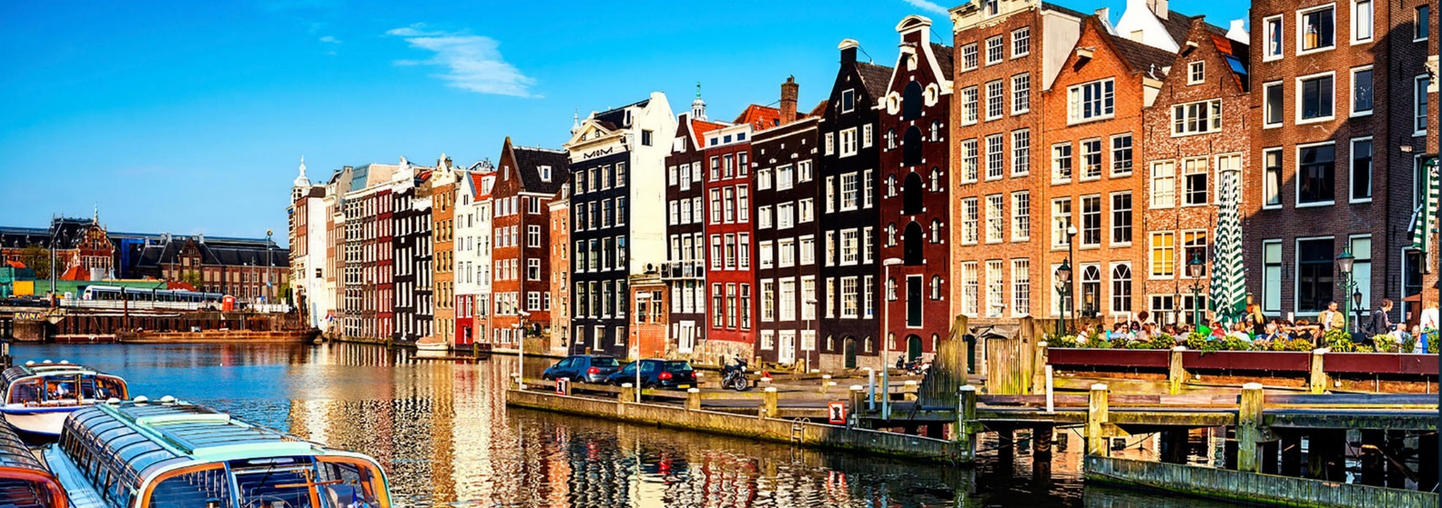

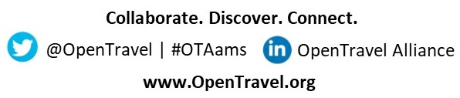
Please Have a Seat: The First Time Attendee Orientation Breakfast will Begin Shortly
First up: 8:45 – 9:45
First Time Attendee Orientation Breakfast
Followed by: 10:00 – 11:30
Advisory Forum Opening Statements & Welcome

Slide 2

Introduction to
OpenTravel

Slide 3
OpenTravel Code of Conduct
Trade associations are perfectly lawful organizations. However, since a trade association is, by definition, an organization of competitors, OpenTravel Alliance (OpenTravel) members must take precautions to ensure that we do not engage in activities which can be interpreted as violating anti-trust or other unfair competition laws. For any activity which is deemed to unreasonably restrain trade, OpenTravel, its members and individual representatives may be subject to severe legal penalties, regardless of our otherwise beneficial objectives. It is important to realize, therefore, that an action that may seem to make "good business sense" can injure competition and therefore be prohibited under the antitrust or unfair competition laws. To ensure that we conduct all meetings and gatherings in strict compliance with any such laws and agreements in any part of the world, the OpenTravel Code of Conduct is to be distributed and/or read aloud at all such gatherings.
There shall be no discussion of rates, fares, surcharges, conditions, terms or prices of services, allocating or sharing of customers, or refusing to deal with a particular supplier or class of suppliers. Neither serious nor flippant remarks about such subjects will be permitted. OpenTravel shall not issue recommendations about any of the above subjects or distribute to its members any publication concerning such matters. No discussions that directly or indirectly fix purchase or selling prices may take place. There shall be no discussions of members, marketing, pricing or service plans. All OpenTravel related meetings shall be conducted in accordance with a previously prepared and distributed agenda. If you are uncomfortable about the direction that you believe a discussion is heading, you should say so promptly. Members may have varying views about issues that OpenTravel deals with. They are encouraged to express themselves in OpenTravel activities. However, official OpenTravel communications to the public are the sole responsibility of the OpenTravel Board of Directors. To avoid creating confusion among the public, therefore, the Board must approve press releases and any other forms of official OpenTravel communications to the public before they are released.

Slide 4

Agenda
Who is OpenTravel?
OpenTravel Organizational Structure
OpenTravel Body of Work
OpenTravel Specification Enhancement & Release Process
OpenTravel Resources
Getting Involved

Slide 5

Who is OpenTravel

Slide 6

OpenTravel is…
Self-funded, non-profit organization
Founded in 1999
Creator of industry wide, open messaging specifications
Promoter of messages
Enabling the future of travel by driving the evolving digital experience for consumers.

Slide 7

OpenTravel Vision
Vision
Open Travel is the source for the most adopted, cross-industry technology standards that enable business solutions driven by the travel community.

Slide 8
Travel Segments and Functions Served
Hotels & Hostels
Airlines
Car rental companies
Cruise lines
Railways
Ground transportation
Tour operators
Travel agents
Destination providers
Golf providers
Insurance providers
Application Connectivity
Booking Documents & Queues
Check-ins & Check-outs
Customer and Partner Accounts
Customer Profiles
Descriptive Information
Dining & Meal Plans
Error & Warning Handling
Fares & Booking Rules
File Attachments
Groups & RFPs
Holds & Unholds
Inventory
Inventory Exchanges
Itineraries
Locations
Loyalty Programs
Non-Inventory Items
Notifications
Packages & Dynamic Packaging
Payment & Identification Verification
Pricing, Quotes & Commissions
Rates & Rate Rules
Reservations (Bookings)
Search & Availability
Search & Display (No Availability)
Seat Availability & Information
Shore Excursions
Special Services
Terminal Messaging
Ticket Fulfillment

Slide 9

Benefits of Membership
Marketplace credibility
Initiate, lead and participate in project teams
Influence standards structure
Member’s only documentation and websites
Early access to specifications
Network with potential partners/ customers
Preferred pricing to OpenTravel events

Slide 10

OpenTravel Organizational Structure

Slide 11
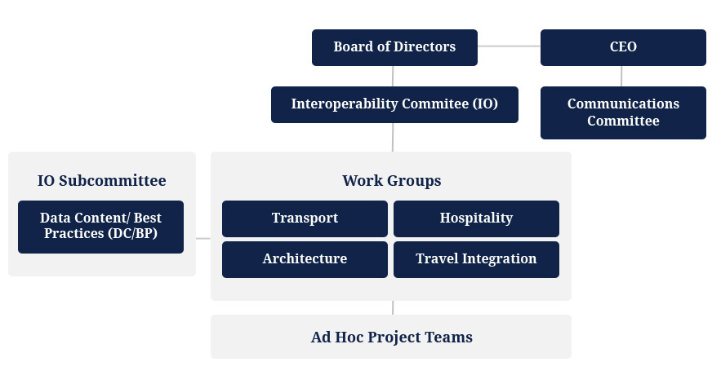
OpenTravel Governing Structure
Strategic Direction of OpenTravel
Oversight of Subcommittees and workgroups
Technical
Subject Matter Experts

Slide 12

OpenTravel Body of Work

Slide 13

OpenTravel Specifications
Our Specification Philosophy
  Support both mature and emerging travel industry segments
  Promote message and object re-use when possible
  Support emerging travel industry trends & business processes
  Provide the specification freely and openly to any implementer to maximize adoption
  The specification can be downloaded from the Opentravel Website
  http://opentravelmodel.net/pubs/specifications/Specifications.html

Slide 14
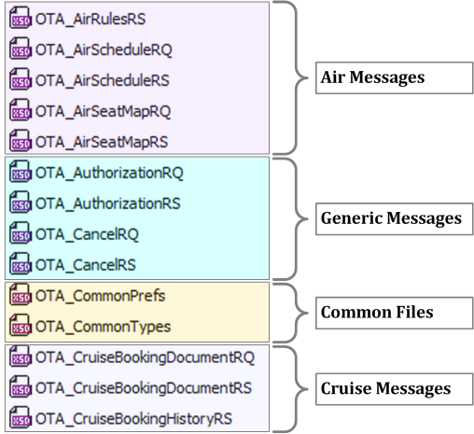
1.0 Message Suite
OpenTravel 1.0 Schema
  Over 290 messages and supporting files & artifacts
  Messages named & organized by travel industry verticals
  Numerous schema-supporting artifacts

Slide 15
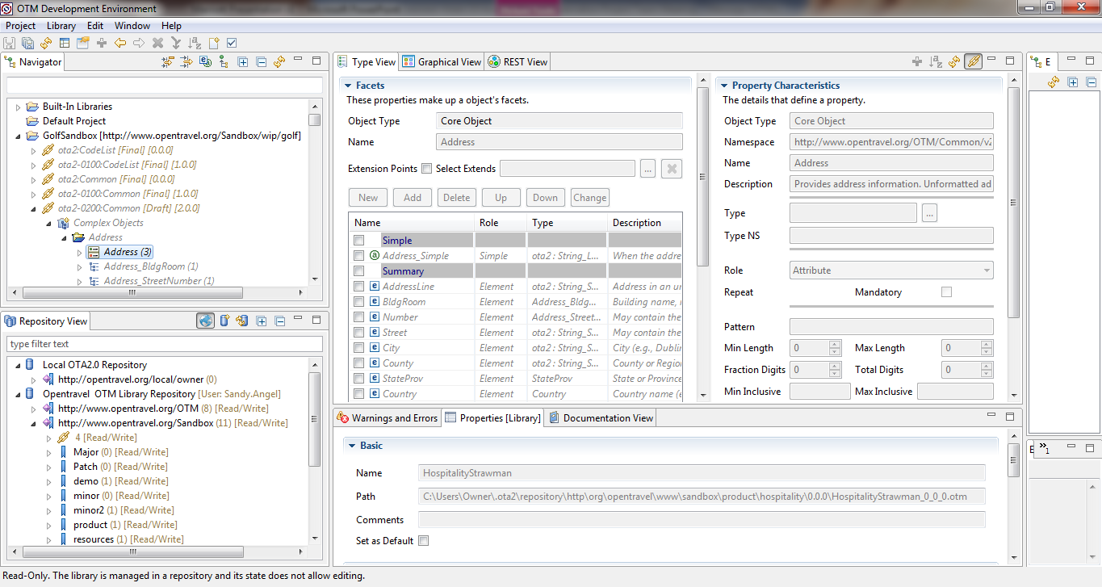
2.0 Object Suite
OpenTravel 2.0 is…
  A model used to design information objects in libraries​
  A repository to share and reuse libraries of objects
  Schemas ​that describe reusable travel objects​
  Designed in an open-source tool to increase consistency and ease of development

Slide 16
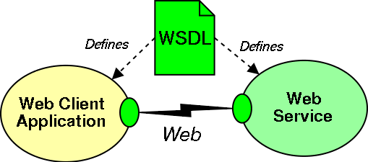
2.0 Object Model
Bi-Lingual – generated in XML and JSON
Tooling generates WSDLs, Swagger, Documentation and Examples
Scalable – built in a tiered fashion to support both robust and lightweight applications
Extensible and Customizable - Implementers make proprietary extensions at the model level

Slide 17
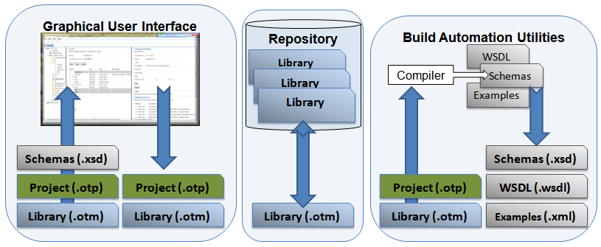
2.0 Tooling = OTM-DE
OTM-DE = OpenTravel Model - Development Environment
  Encapsulates the OpenTravel 2.0 XML Schema Best Practices
  Provides tools to develop OTM objects and other artifacts
  Open source tool available for download from GitHub
  Parts:
    Model Designer
    Repository
    Build Automation Utilities
      Message Compiler
      XML Schema and WSDL generators
      JSON and Swagger generators

Slide 18

OpenTravel Enhancement and Release Process

Slide 19
OpenTravel Workgroups
Four OpenTravel Workgroups
  Architecture
  Hospitality
  Transport
  Travel Integration
Serves all aspects of the OpenTravel specification which are outside the contents of the XML messages themselves and which generally affect all of the other workgroups equally
Serves the needs of the hotel, hostel, vacation rental and cruise verticals
Serves the needs of the air, car rental, ground transportation and rail verticals
Serves the needs of the tour & package tour suppliers, travel insurance providers, destination activity suppliers, golf suppliers, travel itinerary consumers, loyalty program managers and customer profile consumers

Slide 20

OpenTravel Project Teams
Functional teams within an OpenTravel workgroup
Two member companies sponsor the project
Sponsors create a project team proposal
Participants from OpenTravel member companies
Work groups review work
Project Team disbands when project work is completed

Slide 21

Project Team Proposals
Created by OpenTravel members with emerging business needs
Three types of project team proposals
  Schema development
  Business requirements definition
  Study
Select proposal form
Complete and submit
Workgroup review
Interoperability (IO) Committee review
Project work begins
Workgroup final review
Work published
Project team disbanded

Slide 22
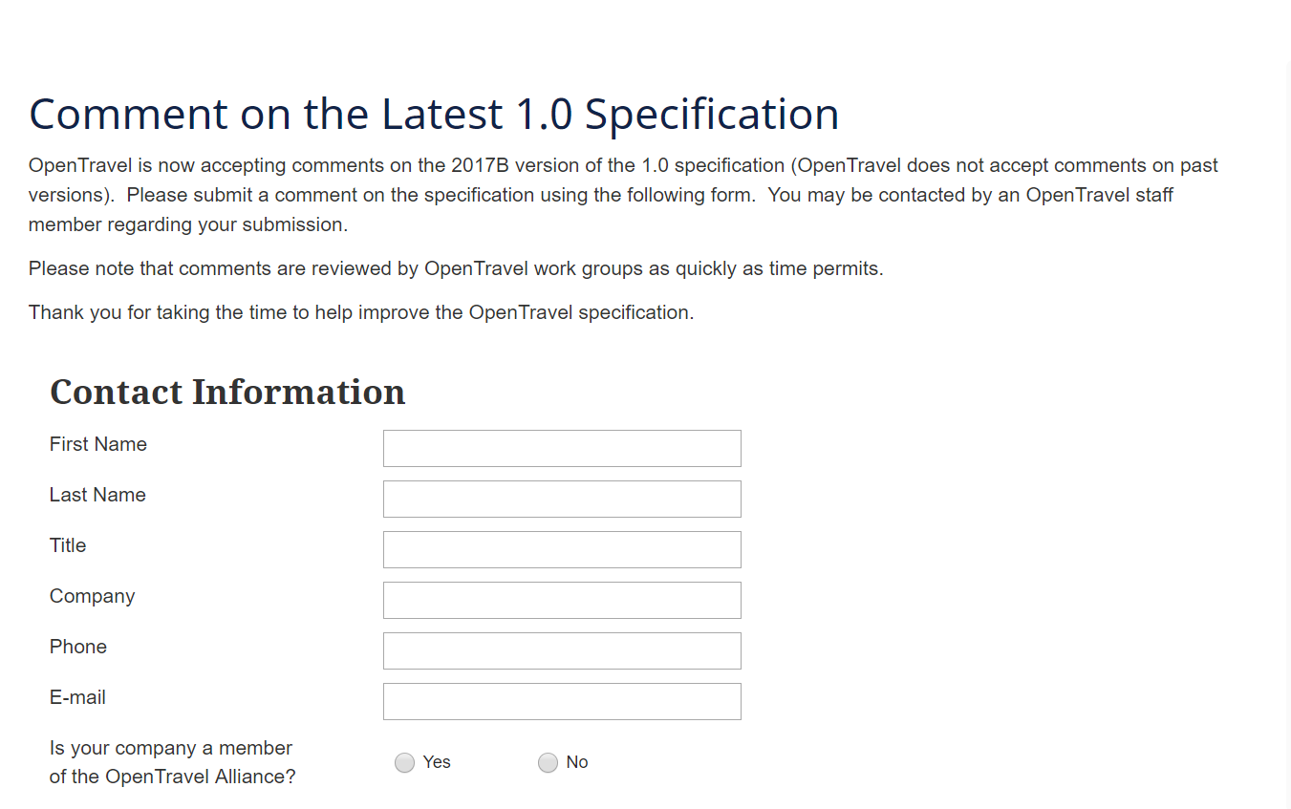
Specification Comments
Available to all OpenTravel implementers
Comments submitted on latest OpenTravel specification
Stored in OpenTravel Comment Manager database
Three types of comments
  Technical
  Editorial
  Business

Slide 23

OpenTravel Resources

Slide 24
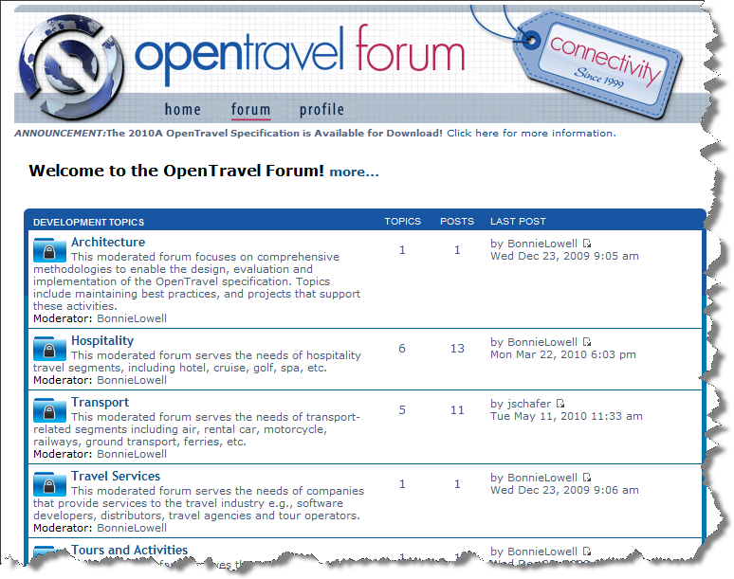
OpenTravel Forum
An extensive web-based discussion forum, useful for
  - asking questions
  - accessing documentation
  - subscribing to lists
  - seeing tools and products
Topics moderated by OpenTravel professionals.

Slide 25
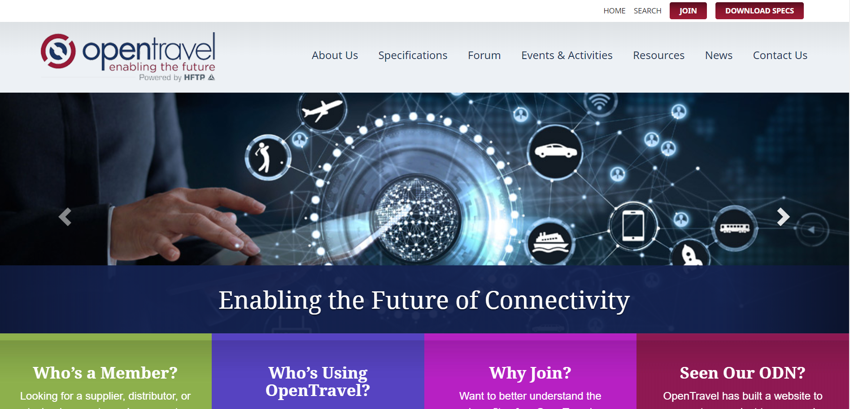
OpenTravel Website
Download the OpenTravel Specifications
Submit Comments
Stay current with OpenTravel news and events
Link to Resources

Slide 26
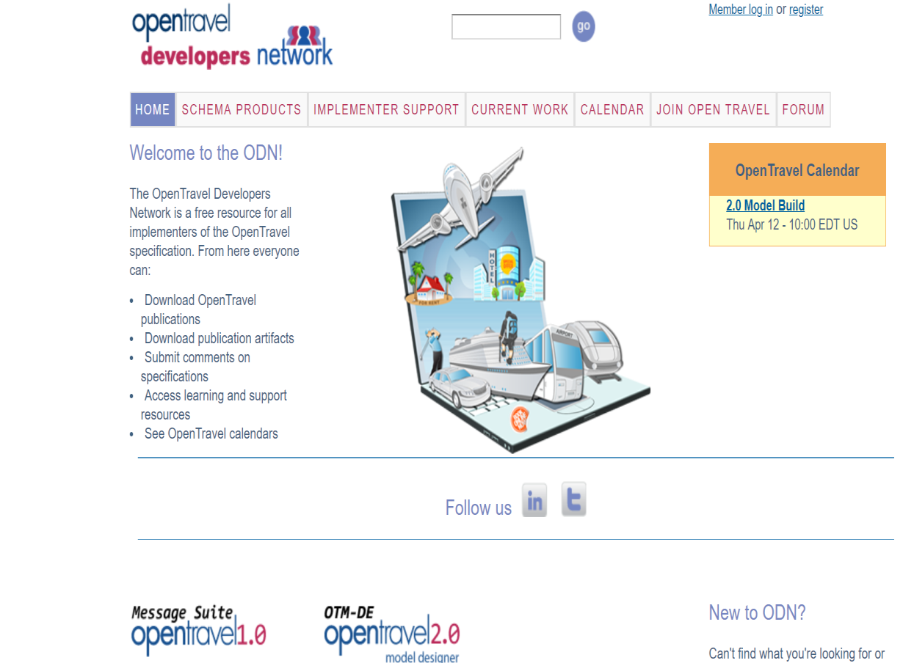
OpenTravel Developers Network (ODN)
Access details about our schema products
Download the OpenTravel Model – Development Environment
Access our Meeting Calendar
Member? Register to access additional information

Slide 27

Getting Involved

Slide 28

How can members participate?
Attend Advisory Forum and other events (via mailing lists and www.opentravel.org)
Register for work group and project team mailing lists
Submit comments on messages your company has implemented
Participate in a work group or project team, or create a project team proposal to address a business problem you and your trading partners have
Run for a work group or committee leadership role
Represent OpenTravel inside you organization
Email info@opentravel.org or visit www.opentravel.org/Join/ for more information.

Slide 29
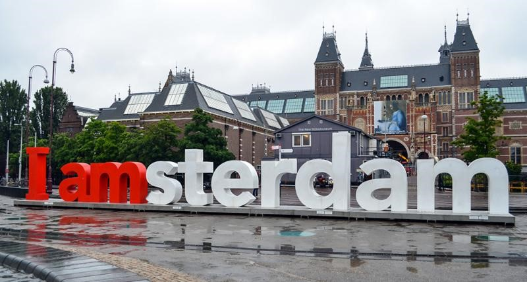
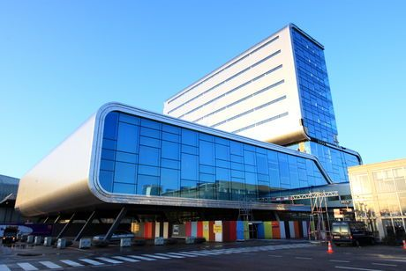
Please Have a Seat: The Opening Session is about to begin

Slide 30
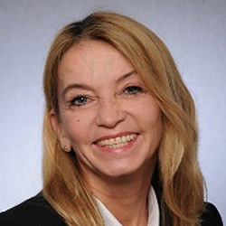

Opening Remarks
Susanne Auinger, Senior Partner Account Manager,
DB System GmbH,
OpenTravel Alliance Executive Committee Chair
Mike Tinkey, CEO, OpenTravel Alliance
+1 (843) 437-0070
mike.tinkey@opentravel.org
Next up: 10:00 – 11:30, Opening Session: Travel Distribution and
the Digital Consumer Experience in a Connected World
Followed by: 11:30 – 11:45, Networking Break in Ruby Lounge

Slide 31
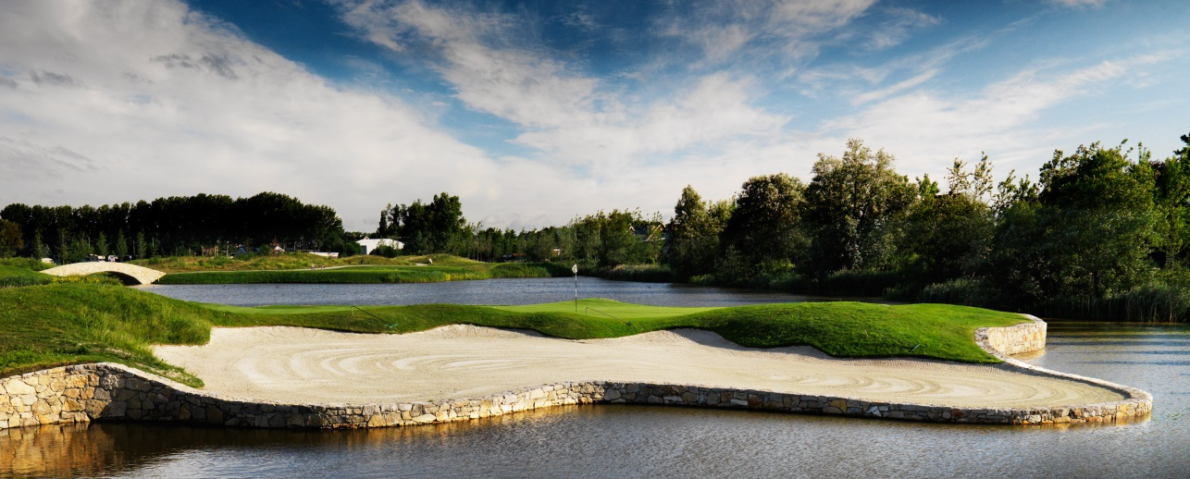
Making the Most of the Advisory Forum
Collaborate. Discover. Connect. We have a great lineup planned for you.
Engage. Ask questions, this forum is designed to be an open discussion.
Connect. Make an effort to network with your peers & make some new friends today.
Stay Social. Tweet your experiences and photos to @OpenTravel using #OTAams

Slide 32
“The few carry the water for the many.” Anonymous
“Never believe that a few caring people can’t change the world. For indeed, that’s all who ever have.” Margaret Mead
“People of accomplishment rarely sit back and let things happen to them. They go out and happen to things.” Leonardo da Vinci

Slide 33
Code of Conduct
Trade associations are perfectly lawful organizations. However, since a trade association is, by definition, an organization of competitors, OpenTravel Alliance (OpenTravel) members must take precautions to ensure that we do not engage in activities which can be interpreted as violating anti-trust or other unfair competition laws. For any activity which is deemed to unreasonably restrain trade, OpenTravel, its members and individual representatives may be subject to severe legal penalties, regardless of our otherwise beneficial objectives. It is important to realize, therefore, that an action that may seem to make "good business sense" can injure competition and therefore be prohibited under the antitrust or unfair competition laws. To ensure that we conduct all meetings and gatherings in strict compliance with any such laws and agreements in any part of the world, the OpenTravel Code of Conduct is to be distributed and/or read aloud at all such gatherings.
There shall be no discussion of rates, fares, surcharges, conditions, terms or prices of services, allocating or sharing of customers, or refusing to deal with a particular supplier or class of suppliers. Neither serious nor flippant remarks about such subjects will be permitted. OpenTravel shall not issue recommendations about any of the above subjects or distribute to its members any publication concerning such matters. No discussions that directly or indirectly fix purchase or selling prices may take place. There shall be no discussions of members, marketing, pricing or service plans. All OpenTravel related meetings shall be conducted in accordance with a previously prepared and distributed agenda. If you are uncomfortable about the direction that you believe a discussion is heading, you should say so promptly. Members may have varying views about issues that OpenTravel deals with. They are encouraged to express themselves in OpenTravel activities. However, official OpenTravel communications to the public are the sole responsibility of the OpenTravel Board of Directors. To avoid creating confusion among the public, therefore, the Board must approve press releases and any other forms of official OpenTravel communications to the public before they are released.

Slide 34

Thank You Organizing Committee
OpenTravel Advisory Forum Amsterdam 2018 Organizing Committee
Susanne Auinger, Senior Partner Account Manager, DB System GmbH, OpenTravel Alliance Executive Committee Chair
Alexander Aigner, DB Systel GmbH
Buddy Altus, Avis Budget Group
Sandy Angel, OpenTravel Alliance
Brian Bell, LinksRez
Matt Blackmon, Switchfly
Paul Byrne, OpenJaw
Lisa Fues, Marriott
Jennifer Mays, Sabre
Greg Poirier, Xenia Hospitality Advisors
Gene Quinn, Advisory Board OpenTravel and WayBlazer
Mike Tinkey, OpenTravel Alliance
David Velasquez, LinksRez
John-Peter Veldkamp, Ximedes
Jorge Vieira da Silva, MTA
Stuart Waldron, Travelport
Tony Williams, TTI

Slide 35

Welcome from HFTP
Frank Wolfe, CAE, CEO of HFTP

Slide 36

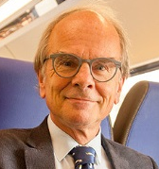


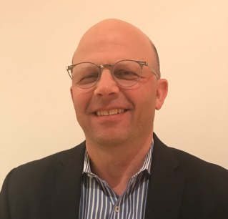
Opening Session: Travel Distribution and the
Digital Consumer Experience in a Connected World
Gene Quinn, Co-Founder, Tnooz, Confluence Partners, LLC
Arriën Kruyt, Member of the Management Board, European Passengers' Federation
Dee Waddell, Global Managing Director, Travel & Transportation Industries, IBM
Kevin Thomas, Chief Software Architect, Travelport Digital
Buddy Altus, VP Innovation Customer & Partner e-Commerce, Avis Budget Group, OpenTravel Alliance Executive Committee Vice Chair
Next up: 11:30 – 11:45, Networking Break in Ruby Lounge
Followed by: 11:45 – 13:00, Evolving Distribution Standards and
the Travel Industry Panel: Blockchain, Identity, Payment, Machine Learning

Slide 37
Networking Break
Time for some coffee in the Ruby Lounge!
Next up: 11:45 – 13:00, Evolving Distribution Standards and the Travel Industry Panel:
Blockchain, Identity, Payment, Machine Learning
Followed by: 13:00 – 14:30, Networking Luncheon in Ruby Lounge

Slide 38
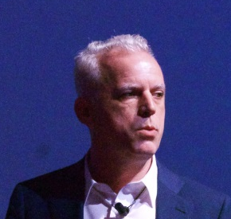

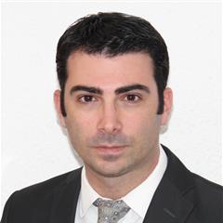
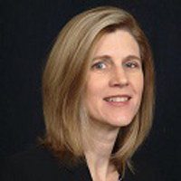
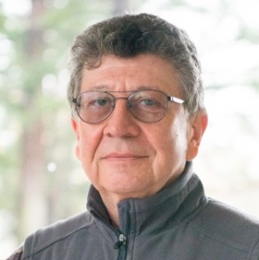


Evolving Distribution Standards and the Travel Industry Panel:
Blockchain, Identity, Payment, Machine Learning
Brian Lewis, CTO, OpenJaw Technologies Ltd (a Travelsky Company)
Christian Kameir, International Blockchain and ICO Solutions
Vanni Sanvincenti, Lead NDC Architect, International Air Transport Association (IATA)
Sandy Angel, Director of Specifications, OpenTravel Alliance
Jacob Dreyband, Senior Director of Software Development, Versonix Corporation
Greg Land, Global Industry Leader, Aviation, Hospitality & Travel Related Services, IBM
Stuart Waldron, VP Tech Architecture, Travelport (Moderator)
Next up: 13:00 – 14:30, Networking Luncheon in Ruby Lounge
Followed by: 14:30 – 15:45, Putting OpenTravel to Work for You: Best Practices for
Customer Experience, Revenue Generation and Efficiency Part 1

Slide 39
Problem Statement
The distribution of travel product is evolving along with the retailing model. Suppliers are creating more choices in their offerings augmenting with ancillary goods and services along with upselling higher and more diverse levels of service. At the same time, customer facing channels such as travel agencies, online travel agencies, travel management companies and corporate travel agencies are packaging multiple travel components to create a total trip experience. This is creating new challenges for the distribution of actionable travel content. Agreements on message formats alone no longer suffice to support sophisticated approaches to retailing travel products across a variety of channels.

Slide 40
Topics
The role of APIs over messages
Identity management and privacy concerns across retailers and suppliers
  The role of social media
Shared views of
  Reservations
  Identity
  Payment and reconciliation
The role of OpenTravel as an entity across the travel verticals

Slide 41
Networking Luncheon
Enjoy Lunch in the Ruby Lounge!
Next up: 14:30 – 15:45, Putting OpenTravel to Work for You: Best Practices for
Customer Experience, Revenue Generation and Efficiency Part 1
Followed by: 15:45 – 16:00, Networking Break in Ruby Lounge

Slide 42

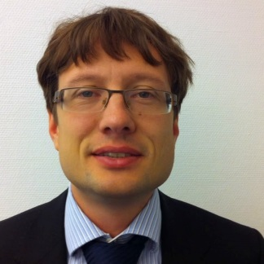
Putting OpenTravel to Work for You: Best Practices for Customer Experience, Revenue Generation and Efficiency Part 1
MASAI Seamless Travel Europe with Ground Transportation, Concierge, Long Distance Bus, Destination Marketing and More
Susanne Auinger, Senior Partner Account Manager, DB System GmbH,
OpenTravel Alliance Executive Committee Chair
João Almeida, President, MASAI Mobility Community
Alexander Aigner, Interim Manager, DB Systel GmbH
Travelport Case Study
Stuart Waldron, VP Tech Architecture, Travelport (Moderator)
Next up: 15:45 – 16:00, Networking Break in Ruby Lounge
Followed by: 16:00 – 17:15, Putting OpenTravel to Work for You: Best Practices for
Customer Experience, Revenue Generation and Efficiency Part 2

Slide 43
Travelport Case Study
Don’t wait for someone else to connect with via OTA 2.0, get started now and see benefits!
Stuart Waldron
VP Technical Architecture Travelport

Slide 44
What is OTA 2.0?
OTA 2.0 is the realization of the Open Travel Model
OTM is beyond XML – it is not just simplification like JSON but also problem definition (and metrics)
XML Schema was NOT designed as an object language—it is a message constraint language
Pre JAXB and JIBX developers bound schemas to objects
JAXB and JIBX use XML Schemas to define objects
  Bindings use to distinguish objects
  XML use to identify message types
  Mismatch occurs when types are used for validation while objects are primary design artifacts
OTM was designed to be an Object language
  Based modeling principles and object orientation
To match XML messages to programming Objects require rethinking:
  Design practices
  Namespace usage
  Versioning Strategies
  Binding Technologies
  Reuse strategies

Slide 45
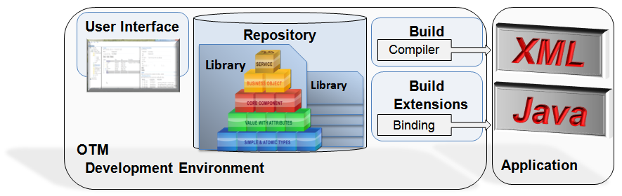
OTM-DE (Design Environment)
Features
  Model Designer user interface
  Repository for sharing object libraries
  Extendable compiler for XML Schemas and WSDL
Benefits
  Reusable libraries encourage object reuse
  Applies style guide automatically
  Schemas support interchangeable levels of detail
OTM-DE used to define canonical objects
Objects model includes various representations that all conform to interface specifications (xsd schema)
Identifiers make the object an accessible resource
Canonical OTM Business Object
ID
Summary
Field1 : Type
Field2 : Type
Field3 : Type
…
Host Data
1G/1V
1P
ACH
…
Desktop
Web
Mobile
Query

Slide 46

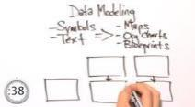






Open Distribution Architecture
Core-Specific
Data
Design
OTM - Nouns
Process – Verbs
Development
Implementation Models
Framework
Manageability
Libraries
Resource Mappings
Build Integration
Deployment (Packaging/Platform)
Registry/Routing/Addressing/Optimization
Testing
Compiled Unit Tests
Integration Test Framework
Detail
Extensions
Translate OTM Models into Working Code Faster and Easier
Efficient Model for Complex Object Data
Enhanced Tools for Service Unit and Integration Testing
Tailored Frameworks for Producing and Consuming Services

Slide 47





Open Distribution Technologies
ODM is comprised of numerous mainstream and leading-edge 21st century technologies…
Service Types
Channel Services
Domain Services
Atomic Resources
Run-Time Components
Service Registry
Interaction Manager
Identity Manager
Host Connectivity Adapter
Framework Components
REST Service Framework
Resource Locator
OTM-API Data Binding
Atomic Transformation Framework
Host ID Mapper
Test Architecture Components
Service Mocking Framework
Scenario Test Runner
Test Data Factory
Development Tools
OTM Development Environment
OTM Repository
OTM Example Helper
OTM Build Automation Plugins

Slide 48
Open Distribution Methodology Benefits
Increased Productivity
Simpler, industry standard based components
Improve Partner Adoption & Retention
Reduced adoption development effort
Core Isolation
Standards based development tools and lifecycles
Reduces ongoing investment in legacy components
Technical Credibility
Stable scalable Products
Enabling rapid change
Enabling new channels
Reducing Skills Dependencies
Developments based on commodity skills
Reduced Total Cost of Ownership
Reduced dependency on hardware and software vendors, reduced chance of vendor lock in
Modern run environments enabling greater automation for provisioning and run.
Modern development environments, Attract and retain qualified technical graduates
Technical Credibility
Niche knowledge requirements greatly reduced due to legacy isolation
Simplifies the sourcing strategy
Modern tooling allows significant automation
Built for cloud and virtualisation

Slide 49
Development Velocity of Project “ResMan”
ResMan uses the Agile Methodology (Agile has proven to be a good fit for ResMan)
105 stories delivered in 10 Sprints (2 weeks / sprint)
Productivity has increased dramatically (ResMan working well as a Team)
Limitation on current metrics
  limited sample size
  only “Happy Path” stories
Future enhancements to metrics
  More diverse sample including Exception and Error Path Stories
  Focus on measuring Atomic and Domain services developed
ResMan CSR 28407 | Sprint 0 | Sprint 1 | Sprint 2 | Sprint 3 | Sprint 4 | Sprint 5 | Sprint 6 | Sprint 7 | Sprint 8 | Sprint 9 | Sprint 10
Number of Sprint Stories | 0 | 2 | 3 | 9 | 7 | 10 | 9 | 15 | 16 | 16 | 17
Core Team Sprint Hours | 624.5 | 509 | 541 | 553 | 559 | 459.5 | 546.5 | 518.5 | 491 | 548 | 435.5
Core Team Hours per Story | NA | 254.5 | 180.3 | 61.4 | 79.9 | 46.0 | 60.7 | 34.6 | 30.7 | 34.3 | 25.6

Slide 50
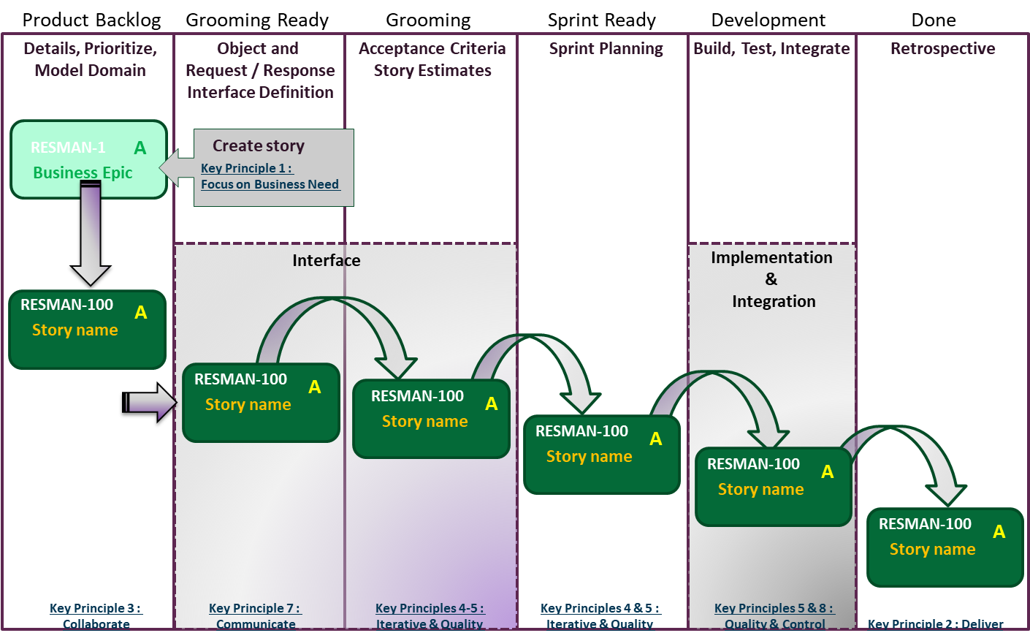
Story Lifecycle

Slide 51
Summary
By adopting OTA 2.0 as the basis of Travelport’s Open Distribution Methodology, we have seen benefits that stand on their own without waiting for a partner to interoperate with
As we roll out new APIs that are easier to use, faster and reliable, we are making our customers happy
It’s an added benefit that we are also capable of using OTA 2.0 with travel partners when they are ready

Slide 52


MASAI Seamless Travel Europe …
…with Concierge, Ground Transportation, Long Distance Bus, Destination Marketing and More
Notes:
Presentation held at the Advisory Forumm OTA in Amsterdam; MASAI and OTA – interaction and achivments
Content:
brief notice where we come from (EU Project/ Consortium) – starting with the challenge we like to solve
vision and mission; what MASAI is about
where OTA comes in
achievements - here we can show our functional scenario – how we use OTA and what we created; Research & Discovery; concierge; ground transport; and want to create – long distance bus …
the benefits, meanings for the different verticals
in this session you learn how an idea driven by a EU Research project on seamless traveling became materialized creating solutions supported by OTA standards and tools as an basic element and how this helps the provider of travel services to create new business models and customer experience.
--- questioning how FSM and OTA might complement.

Slide 53




About the MASAI Project
MASAI project
Mobility based on
Aggregation of
Services and
Applications
Interconnection
EUROPEAN research project on seamless travelling
Grant Agreement 636281
June 2015 – June 2018
Countries & Participants
BE MTA
PT Card4B
FR Digimobee
DE DB Systel
NL Ximedes
Notes:
MASAI is an EU Research Project driven by the EU Comission under Chapter H2020 with the goal to enable the travel industry to easily provide solutions and services in the travel market to create seamless travel experience to their customer.
Started in June 2015 under the Grant Agreeement 636281 since then a consortium of 5 Companies has been working on the perspective of future travelling and its gap regarding todays travel market offering and the customer demand. How can this gap been closed?
MASAI takes the customers perspective, working out tools and specification to help the travel industry to meet the travelers demand.
This project beside the theoretical observation delivers POCs and pilots to prove the functionality of the conception and research results.

Slide 54

Traveller Approach

Slide 55
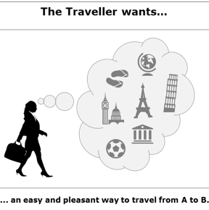
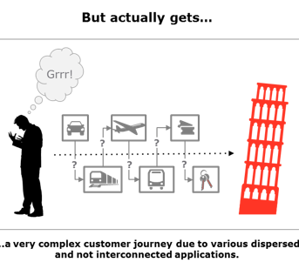

The Challange MASAI wants to solve
…personalisation
…average mess
MASAI supports the Travel industry to overcome Today’s unconnected information in dispersed applications, building an open ecosystem…
… to enable a Seamless door to door Travel Experience, from Discovery to Management
… to serve the customer by providing his personal Concierge.
Notes:
We have the the following initial position of the travel market from the customers view:
The traveller wants an easy and pleasant way to travel from A to B and he wants it personalized – hi idividual demand in every aspect of travel
The traveller actually mes high fragmantation throghout his jouney ‘ an average mess’ in means of transport, channels, tools, etc. and needs to bring effort to get his journey provided end to end.
Even we find aggregators on the market today it is a not individualized, but categorized, not meeting the individual demand.
5 Companies have been working on the perspective of future travelling and its gap regarding todays travel market offering and the customer demand. How can this gap been closed?
MASAI takes the customers perspective, working out tools and specification to help the travel industry to meet the travelers demand.
This project beside the theoretical observation delivers POCs and pilots to prove the functionality of the conception and research results.

Slide 56
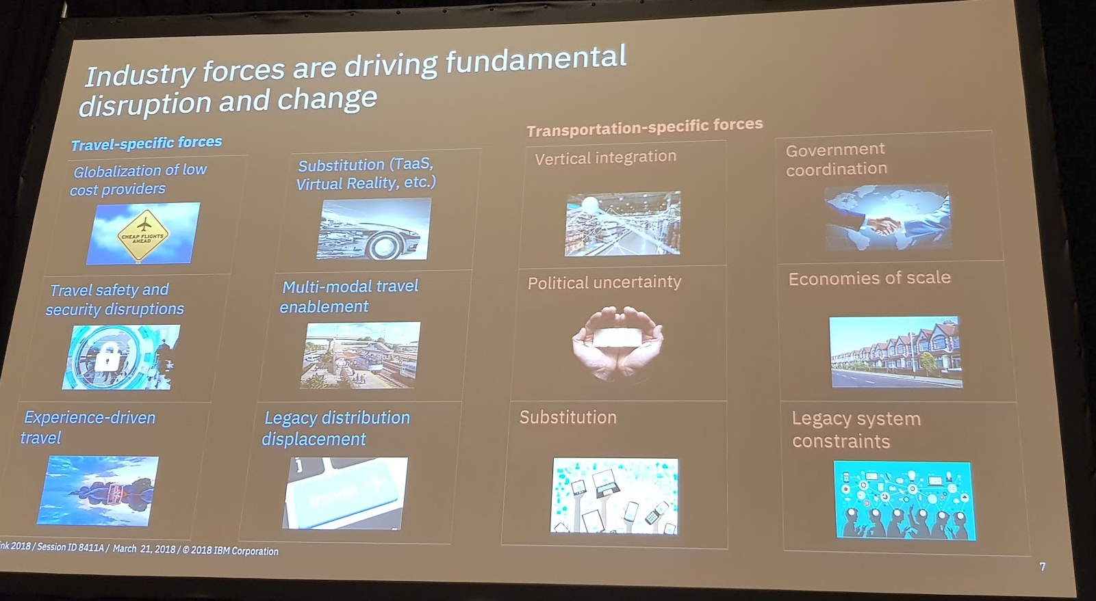
Political Policies and Traveller Force a new Positioning, appropriate Specifications and Tools
tightend political climate:
the European Comission boost its pressure to overcome fragmentation and boarders in travel throughout Europe
market pressure on consumer side meeting individual end to end solutions (personalisation)
Result of MASAI evaluation and research
Interconnection and interoperability of the different verticals demanded
OTA as a technical suitable partner providing qualified
specifications and tools
IBM view on disruption, OTA insights and MASAI research
(Whitebook) show similar conclusions

Slide 57
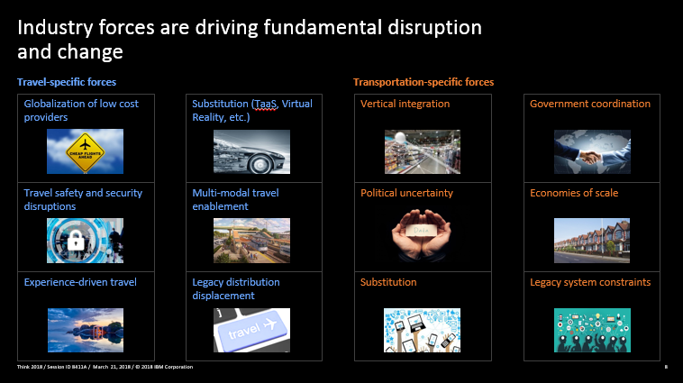
Challenge

Slide 58

What are the MASAI Deliverables
Goal of MASAI
1
Coordination including public presentation, WEBSITE, report
2
WHITEBOOK
Functional & technical specification & implementation guideline
Define, standardise and validate architecture and user attributes, aiming to provide set of specification & tools (APIs) open to anyone
willing to interconnect, promote, expose and enrich their offers with additional value-added services.
3
COMPONENT PROTOTYPES and documentation
4
Integration and internal POC
input for hackathons & pilots
Vision of MASAI
Tendering for pilots changed into
MOBILITY COMMUNITY M2C as
future playground/ platform for pilots
5
One open Ecosystem to enable a seamless door to door travel experience, from discovery to management of travel.
6
Operational support to pilots and ANALYSIS
Promoting MASAI to specific stakeholders
7

Slide 59











Concierge Module & Artificial Intelligence
Tickets & Entitlements
MASAI
Search & Discovery
MASAI
Travel Folder
Standards e.g.
Travellers with
individual requirements
Concierge Module
Global Types & Attributes Repository
Travel Concierge
based on artifical intelligence
Apps in Echtzeit
Redlink Demo Bahn
KLM Chatbot
Expedia Chatbot
API Interfaces with Service Providers
Bahn API (FSM)
Trekksoft API
Booking.com API
…
Concierge Services

Slide 60
MASAI: in the Mobility & Tourism Ecosystem
Discovery
Directory Engine (Centralized)
Domains Ontologies & Vocabularies
Modelling
Publisher
Descriptors
Search Engines (Distributed)
(Need, Disc, Plan)
Concierge Apps & Modules (C)
Service Provider (SP)
APPs
Folder
SP Descriptors
SDK
SP Service
API Marketplaces
Chat Bots
Semantic
Bots & AI
SP Interface
Swagger
MASAI + OTA provides
Opportunities for 3rd Parties facilitated by MASAI
(Need, Disc, Plan,
Book, Pre-travel,
Travel, Reschedule, Post)
Notes:
Please explain the story: third person does not understand
Domains etc – usage, what is delivered / what is it for -> modelling – usage, what is delivered, what is it for... -> publisher usage, what is delivered, what is it for ... Please descibe the arrows as well

Slide 61
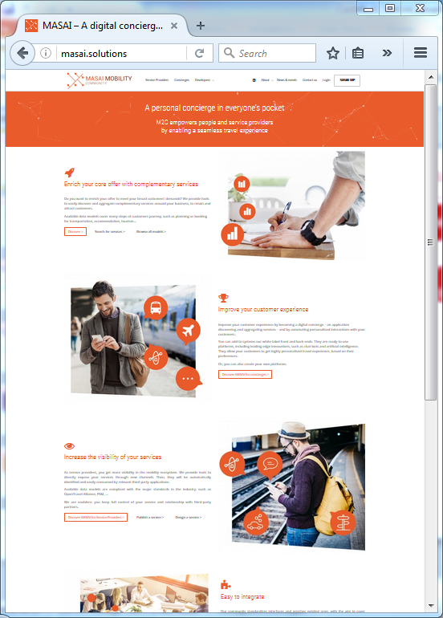



MASAI Mobility Community | Portal & Tools
Portal for:
  Service Providers
  Concierges
Tech Playground
  White-book
  Tutorials
  Specifications
  Components & Tools
  (Open Source / Github)
  Community
  Proofs of Concept
Model
Publish
Service
Descriptor
Discover
SDK
APIs
Chat
“Cards”
Concierge
Chat APP
Folder

Slide 62

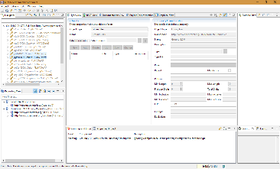
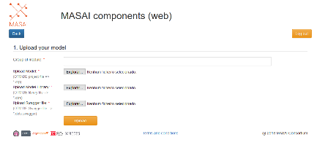
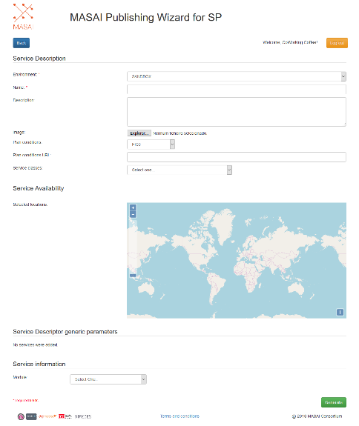
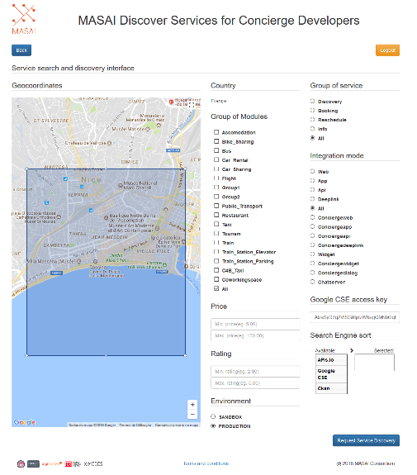
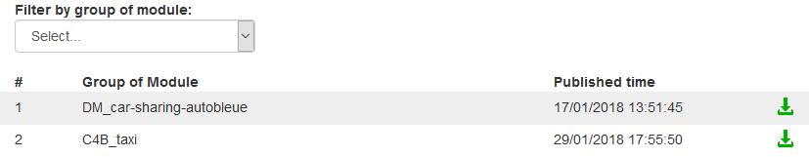
MASAI & OTA working together
1.
Modelling tool (OTM-DE)
2. MASAI
Model Importer tool
3. MASAI
Publishing Wizard
4. MASAI
Service Discovery Web tool
Upload generated files from OpenTravel Modelling Tool
2. MASAI
Model Download
Uploaded models are also available for download after MASAI approval
Publish service using the imported model
Search for published service
+
SDK
Chat
“Cards”
Concierge
Chat APP

Slide 63


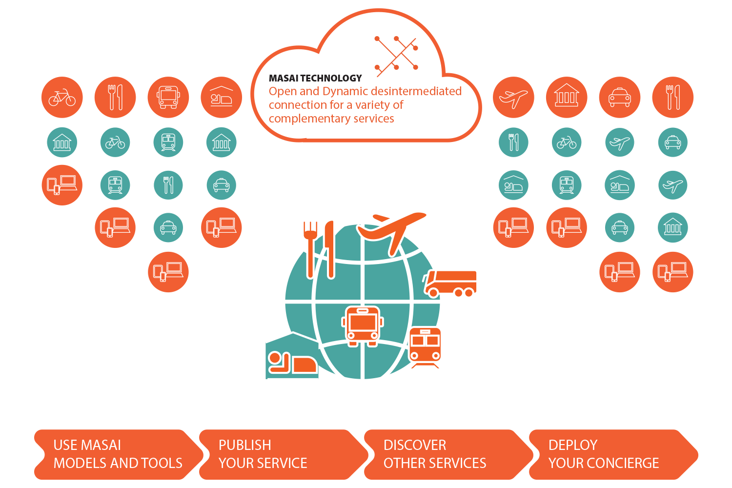
USING MASAI
Use OTA & MASAI
Notes:
Please explain the story: third person does not understand
Domains etc – usage, what is delivered / what is it for -> modelling – usage, what is delivered, what is it for... -> publisher usage, what is delivered, what is it for ... Please descibe the arrows as well

Slide 64







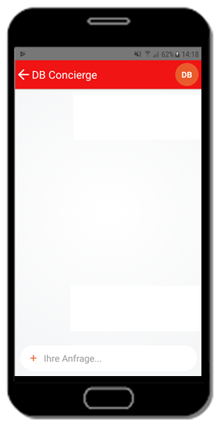






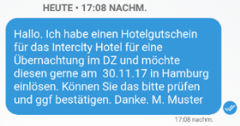





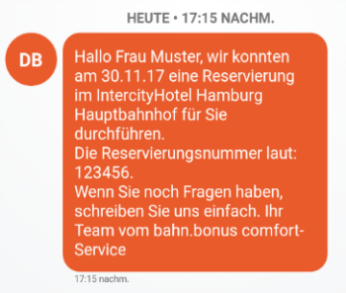







MASAI IS PROVEN IN SEVERAL DEPLOYMENTS
DB Reisebuddy
Hotel Booking
France
DB Reisebuddy
Portugal
Trans Europe

Slide 65
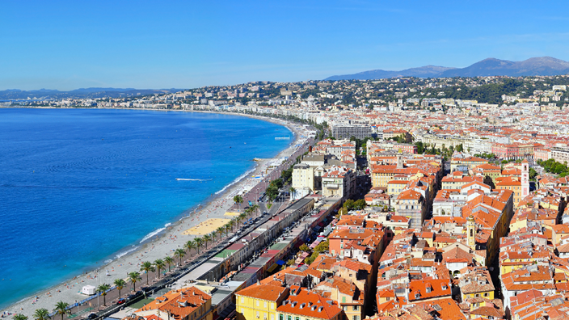




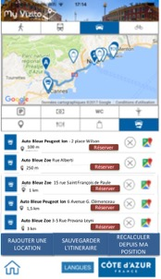
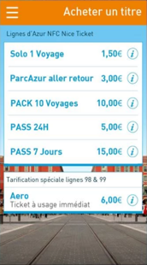
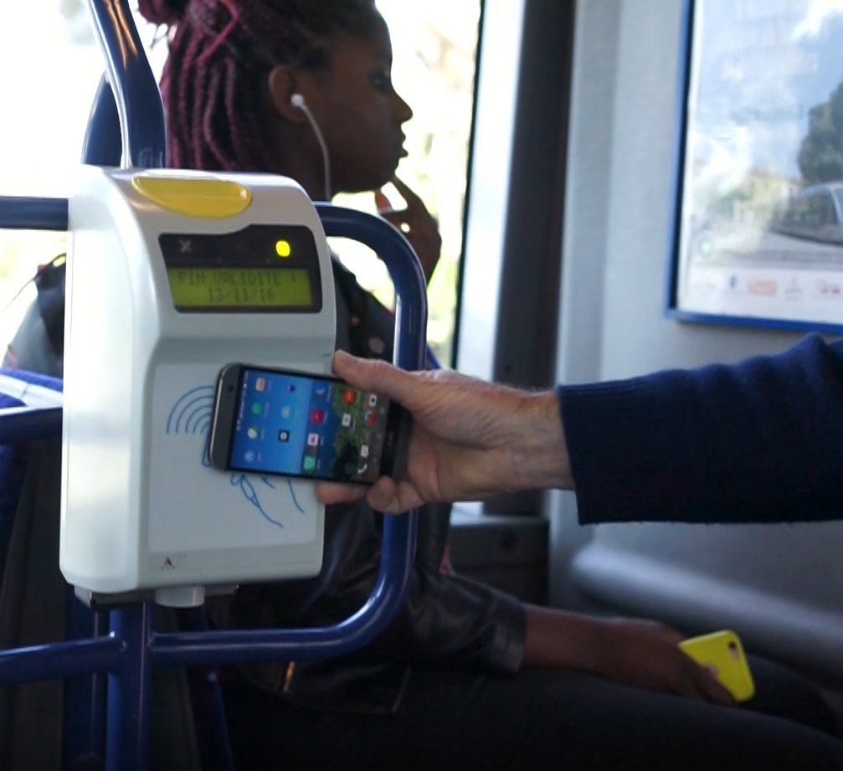
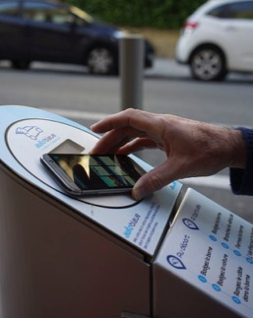

NICE PILOT USE CASE
Provide an e-concierge application for delegates
to organize a touristic trip when they have free time

Slide 66
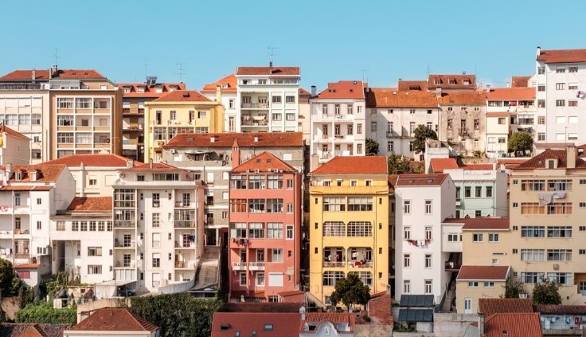
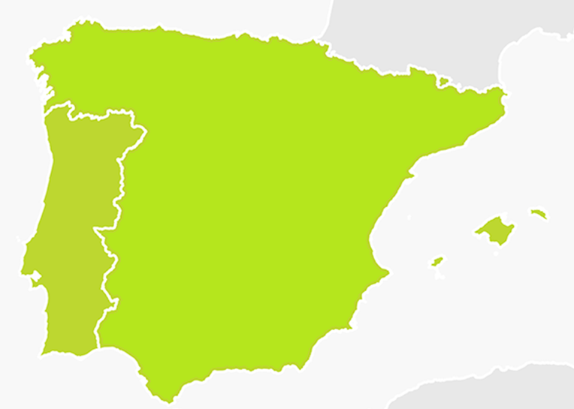
















PORTUGAL PILOT USE CASE
Enabling long distance bus service provider
to aggregate their services and expand their business
Start-ups
Services and Cities
Concierges &
Tourism Marketplaces

Slide 67


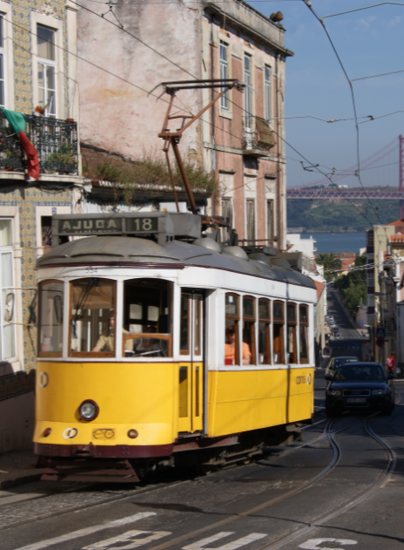
Stakeholders in Portugal
Global Service Providers
Local Service Providers
Cities and Government
Local Start-ups
Global Start-ups
SOL start-up acceleration

Slide 68










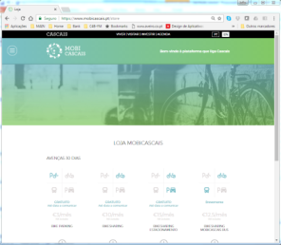
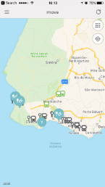







Challenge 1 | Direct | Mobi Cascais, Grayline Tours
City Mobility APP + Bike Sharing + Buses + Parking + Tours + Trains + Transfers + Marketplaces…
Service
Providers
Self-Managed Services
Concierges
Travel Marketplaces’ Connectors

Slide 69
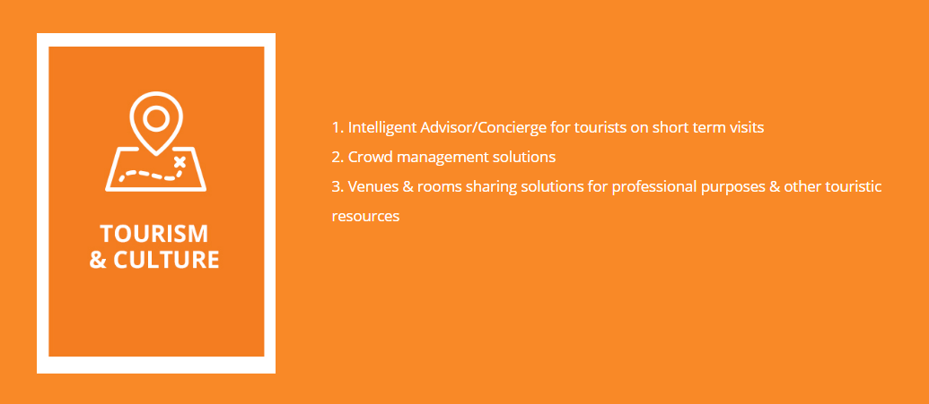





















Challenge 2 | @SOL | assistant for Cruises Tourists
Publish
Discover
Preferences

Slide 70














Challenge 3 | Direct | Rede de Expressos
Long Distance Bus + Last/First Mile + Hotel + Restaurants + Other Channels
Service
Providers
Self-Managed Services
Concierges

Slide 71









Example | Mobi.Cascais APP | Local Bus/Stop Info + Tickets
From the Mobi.Cascais APP it is possible to:
  Purchase tickets for Cascais Buses (Buscas), CP Rail, Scotturb Sub-urban Buses, available in the web store.
  Info about Cascais Buses (BusCas), CP Rail, Scotturb Sub-urban Buses, available in the APP.
  Info about Grayline Buses available in the APP.
  Currently adding the booking of Grayline Touristic Buses, Parking, Bike-sharing, and Taxis/Transfers, and maybe Co-working spaces, will be made available via MASAI mechanisms.
  Links to other services’ web sites (e.g. Carris, Metro), will gradually be replaced by more seamless and intelligent MASAI mechanisms.

Slide 72




TRANS EUROPE PILOT USE CASE
Integrate a broad range of service providers by
Powering the concierge DB Reisebuddy with MASAI
Advantages for customers
Easy communcation through various channels (SMS, mobile app, WebChat, Facebook messenger)
Reliable travel information
Travel solutions in realtime
Relaxed travel journeys
Advantage for companies
Increase of customer satisfaction and market differentiator
Cost reductions
Automatisation by linking the system to artificial intelligence

Slide 73


TRANS EUROPE PILOT USE CASE
DB Reisebuddy
DB Reisebuddy
Hotel Booking

Slide 74










TRANS EUROPE PILOT USE CASE
DB Reisebuddy
Restaurant Booking

Slide 75


USE MASAI PROVEN SOLUTIONS
TO DELIVER A DIGITAL CONCIERGE
IN EVERYONE’S POCKET
JOIN US AT
http://masai.solutions

Slide 76

2.0 Projects on the Horizon
Long Distance Bus
Availability
Booking
Rail
Initial Talks
Notes:
Projects on the horizon include Air Availability and Booking, Hotel Descriptive Content, Rate and Inventory and Rail Availability and Reservation. Our members influence our direction so being involved is key!

Slide 77



Dipl.-Ing. (FH)
Susanne Auinger
Tel. +49 69 265-39183
Mobile +49 15237539183
Susanne.auinger@deutschebahn.com
DB Systel GmbH
Jürgen-Ponto-Platz 1
60329 Frankfurt am Main/ Germany
www.deutschebahn.com/dbsystel
Portfolio & Partnermanagement
Senior Advisor Partnermanagement
(F.IVM4)
> Joao Almeida
(Administrator)
> Joao.almeida@card4b.pt
> +351 969 522 828
Card4B Systems S.A. * Avenida da Igreja 42 * 13 * 1700-239 Lisboa * Portugal
T * +351 213 304 353 * F * +351 213 304 355 * www.card4b.pt
Alexander Aigner
Mobile +49 162 4375830
Alexander.aigner@deutschebahn.com
DB Systel GmbH
Jürgen-Ponto-Platz 1
60329 Frankfurt am Main/ Germany
www.deutschebahn.com/dbsystel
Portfolio & Partnermanagement
Senior Advisor Partnermanagement
(F.IVM4)

Slide 78
Networking Break
Time for some coffee in the Ruby Lounge!
Next up: 16:00 – 17:15, Putting OpenTravel to Work for You:
Best Practices for Customer Experience, Revenue Generation and Efficiency Part 2
Followed by: 17:30 – 19:00, E20X Networking Reception in Ruby Lounge

Slide 79


Putting OpenTravel to Work for You: Best Practices for Customer Experience, Revenue Generation and Efficiency Part 2
Rental Car, Golf, Hospitality and Tourism in France
Avis Budget Group’s Use of the OpenTravel Specification in a World of Mobility
Buddy Altus, VP Innovation Customer & Partner e-Commerce, Avis Budget Group, OpenTravel Alliance Executive Committee Vice Chair
Golf Hospitality and Tourism Case Study
Paul Armitage, General Manager, Le Golf National
Cruise Case Study
Jacob Dreyband, Senior Director of Software Development, Versonix Corporation
Next up: 17:30 – 19:00, E20X Networking Reception in Ruby Lounge
Followed by: 19:00 Explore Amsterdam (Free Time)

Slide 80
Use of the OpenTravel Specification in a World of Mobility
Buddy Altus
Avis Budget Group
VP Innovation, Customer & Partner E-commerce

Slide 81
Agenda
Overview of Avis Budget Group (ABG)
ABG’s use of the OTA specification
Mobility
API economy

Slide 82

Avis Budget Group – Global Leader in Mobility

Slide 83

Global Footprint

Slide 84








  Zipcar, world’s leading car sharing company
  Payless, operates in the deep value segment
  Budget Truck, one of the leading truck rental brands in the US
  Apex, leading deep value segment brand in Australia and New Zealand
  Maggorie, a leading car rental brand in Italy
  France Cars, one of the largest light commercial vehicle fleets in France
  Joint ventures in India & China

Slide 85

ABG’s use of the OTA specification
Founding member and Board member since 1999
Launched first partner in 2003
Partner with Airlines, Hotels, OTA’s, and Credit Card companies
Two connection types, the specification itself or a private label
It is a platform which gives us flexibility
Continued YOY growth for the past 15 years
Growth fueled by standardization
  Easy for partners to connect to us
  Fast to launch
Opportunities
  Share data across suppliers and verticals
  Better servicing, greater customer satisfaction, greater revenue

Slide 86




OUR APPROACH
Rocketspace Relationship
Autonomous Cars & Fleet Management as a Service
Reinventing Rental
Connected Car & Driver
Notes:
Two near term initiatives
Reinventing Rental
Connected Cars & Drivers
Two long term initiatives
Autonomous Cars
Fleet Management & Data as a Service

Slide 87
ABG a Mobility Company - Not your Father’s Rental Car Company
2013-- Zipcar Purchased
2016 - Avis Transforms Car Rental To Give Travelers Complete Control Of Their Experience Via Smartphone
2017 – ABG Partners With Waymo to Support Its Self-Driving Car
2017 – ABG Marching Towards Future of Mobility With Launch of ‘Lab' in Kansas City
2017 – Avis Announces Google Home Integration with Artificial Intelligence Capabilities
2017 – Avis to Launch Voice-Powered Car Reservation Capability With Amazon Alexa
2017 – Avis Budget Group and Continental Partnership Drives Mobility Forward
2018 – Car Sharing Goes Up a Gear in London With Expansion of Zipcar Flex
Notes:
Choose the exact car
Control their rental experience from start to finish:
Confirm, cancel or extend a rental in the app. Lock and unlock doors, or flash the headlights to help find their car. Return the car without assistance, with speed and simplicity
Get real-time updates for peace of mind:
Receive important real-time notifications about their trip. Access an instant view of the rental agreement, confirm fuel or mileage and obtain assistance on demand.

Slide 88

Avis Innovation Making Pick Up & Selection Seamless

Slide 89






What might mobility look like?
Notes:
See mobility as complex ecosystem.
Our goal – work with government to promote more sustainable options today, leverage public parking, public transit…
Promote mix of options, make more visible…
It’s an ecosystem…. Cultivated, complex.
Public partnerships… hard

Slide 90
Mobility & OpenTravel what’s the connection?
ABG sees mobility as an eco-system
The eco-system leverages the API economy
Using services to build applications
ABG will expose APIs to partners, customers, and ourselves
Allowing applications to be built faster and easier
New modes of mobility and mobility services become possible
OpenTravel as a standards body has an important role to play
Helping different segments of the travel mobility industries communicate

Slide 91
JOIN US!
Notes:
Call to Action: open standards, collaboration and integration
Pace of innovation too fast for any single company to do it all
Interoperability and integration will result in better customer experiences
Open Travel Alliance
NAB PILOT Program
Details on our goals
UK Smart Mobility Living Lab
All of us in this room should be looking for ways to work together to leverage these powerful new connected platforms

Slide 92
Thank you
Buddy Altus
VP, Innovation, Customer & Partner E-Commerce
Office: 973 496 3373
Email: buddy.altus@avisbudget.com

Slide 93

OTA API Implementation Case Study
THE ULTIMATE RESERVATION SYSTEM

Slide 94

Seaware System Components

Slide 95

SwOTA Gateway Server
Seaware
Bizlogic
XML API
OTA API Server
(Tomcat)
OTA API
Distribution Channels
Travel
Agent/Trade
Self Service
Call Center
Global Distribution
System
Web
Mobile

Slide 96
OTA API Implementation
Our OTA-based application programming interface (API) is provided for the purpose of integration with Seaware system.
SwOTA is a web service (SOAP or REST) of OTA v1.0 spec implementation by Versonix
Our latest Versonix OTA specification and SwOTA implementation is version 1.20

Slide 97
Areas Covered by SwOTA API Implementation
Availability search of sail/fare/then category/cabin
Optional search for available land packages/hotels/dinings/addons
Make a booking with guest/client data and above found cruise stuff
Retrieve booking
Cancel booking (with option to view charges before cancelling)
Update booking ( using existing res id)
Profile messages to manipulate client and agent profiles.
Notification (reverse access) sent to subscribers when booking is modified in the system

Slide 98

SwOTA Online Documentation

Slide 99
Notes on SwOTA API implementation
On-line documentation is available at http://ota.versonix.com:18280
Some additional functionality needed by our business practice is not covered by OTA spec.
Versonix implemented additional functionality via extensions or new messages in the OTA suggested format
Versonix specific functionality can be turned on or off for a specific implementation
We submit proposed changes to OTA
Example: OTA_CruiseFacilityAvailRQ/RS and SelectedFacilities node in BookR(exampleQ and ResRetireveRS).

Slide 100
Notes on SwOTA API authentication implementation
OTA has POS element (Point of Sale) which provides info about where is request coming from (agency PseudoCityCode, SABRE agent ID, etc.). We use it for Seaware to pass client/agent/agency IDs.
OTA does not explicitly provide security / authentication APIs. We added login and logout calls to our implementation of API.
By performing login call in the beginning one gets a Seaware session token. Then in all subsequent calls POS can be left empty, as long as one sends corresponding HTTP header with the session token. Then the POS is assumed to be the user ID that was used with login call (agency/agent/client).

Slide 101




Current Clients using SwOTA

Slide 102

SwOTA usage case example
Crystal B2B UI
SW OTA
Crystal core system
(Seaware)
SW OTA
Sabre
Odysseus
Revelex
TravelTek
3rd Party Systems

Slide 103


Open Travel for Die Hard Golfers
THE new bucket list destination

Slide 104




Who are we?
Before 1987 Between 1987 and 1990

Slide 105








Slide 106






2014 to today – Change Management
Services, standards and sales
Inspired by other industries to develop revenues

Slide 107



Three steps forward and two back
Fast growth in Golf sales was needed – our strategy focussed on opening up our platforms and using new technologies
Our friends :
Bookers
Resellers
Brand to brand
Channel Managers
Yield programs
Own platforms
Webshop
Applications
White labelling
…….
Before 2011 – No Online sales
2011 – 2014 – Open for on line « limited » sales
Since 2015 – using open platforms for revenue generation

Slide 108
Rapid Growth and trouble shooting
Hurdles and trouble shooting:
Conflict in interest
Customer experience priority
Spirit and open mindedness
Vision for the golf industry
Technology and language
Market size

Slide 109

Conclusion
Golfers are travellers by definition
60 million of them and they all have their own bucket list !
Let’s help them, from the comforts of their own home, or via their favorite travel agent help them to get that golden tee time!

Slide 110
Open Travel for Die Hard Golfers
THE new bucket list destination
Thanks for listening!

Slide 111
Networking Reception
E20X Networking Reception in the Ruby Lounge
Reminders for Tomorrow
Networking Breakfast: 8:00 – 8:45, Ruby Lounge
HITEC Opening Keynote (Included in your Forum Registration)
Thursday, 12 April 2018, 9:00 – 10:30, the Forum
OpenTravel Advisory Forum: 11:00 – 18:30, E103
Next up: 19:00 Explore Amsterdam (Free Time)
Followed by: See You Tomorrow | Networking Breakfast @ 8:00 in Ruby Lounge

Slide 112

Enjoy Amsterdam – Have a Great Evening

